Slide 1
5/6R
Space Exploration Term 2

Slide 2
Charlotte and Lily
Mercury
Mercury takes 88 earth days to revolve around the sun. Mercury has no moons. Mercury is the smallest planet and it's only 2439.7 km big. Mercury is 66.314 million km away from the sun. Mercury is a slight purple, black and orange. Mercury has a core of solid iron about 4000km wide. There are cases of water that may exist on the bottom of Mercury's core. If you weighed 50kg on earth you would weigh 18.86kg on Mercury. Did you know that you can see Mercury with a naked eye!

Slide 3
Emily and Ella
Venus
Did you know that Venus does not have any moons. It takes 225 earth days for Venus to revolve around the sun. The size of venus is 6,051.8 km. The colour of venus is white. Tremendous pressure on top of it keeps it all solid. There is no water floating around on the surface of Venus. The distance from the sun is 107.51 million km. So an object or person on Venus would weigh 90.42% its weight on earth. Therefore, a person would be lighter on Venus than on earth.

Slide 4
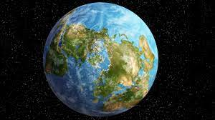
Addison and Nataliya
Earth
Earth takes 365 days, 5 hours, 59 seconds to revolve around the sun. The Earth has 1 big moon. The size of earth is 6,371 km. The distance from earth to the sun is 151.52 million km. The Earth has many colors blue, green, Light green, white, brown when looking from above. The Earth's core is very hot and the core is made up of 2 layers. The Earth has many water catchments:
Water source | Water volume, in cubic miles | Present of total water
Ocean seas and bays | 321,000,000 | 96.54
Ice caps and snow | 5,773,000 | 1.74
Ground water | 5,614,000 | 1.69
fresh | 2,526,000 | 0.76

Slide 5
Nicholas and Deekan
MARS
The time it takes to revolve around the sun? 686.93 earth days
How many moons does the planet have? 2 moons
What is the size of the planet? 3,389.5 km
The distance from the sun? 249.46 million km
What colour is the planet? Red planet
What is at the core of each planet? Hot liquid core
Is there water on the planet? It is almost all water

Slide 6
Cameron and Alex
Jupiter
It takes 12 years for Jupiter to orbit the sun
Jupiter has over 75 moons
It is 61.42 billion km2
The distance from the sun is 778.5 million km
The main colors are white, red and orange.
Jupiter is made up of lots of gases
Jupiter's core is mostly made up of hydrogen and helium
There is a small amount of water
You would 126.35 kg on jupiter
Fun facts: Jupiter can not become a star.

Slide 7
Seth, Patrick and Fynn
Saturn
Saturn takes 10,756 earth days to go around the sun. It has 82 moons around it and has a size of 58,232km. Saturn is 1.4876 billion km away from the sun. It is the colour of black. The core is made of iron and iron nickel. Saturn does have water it is in its ring. A human would be heavier then they were on earth.

Slide 8
Tilly, Kate and Victoria
Uranus
Uranus is made of water. Uranus has 27 moons. It takes 84 years to orbit around the sun. If you weighed 50kg on Earth how much would you weigh on Uranus: 46.0. The size of Uranus is 25,362 Km. The core of Uranus is made up of Methane, Ammonia Ice and Icy stuff! The color of Uranus is Pale Blue. The distance from the sun is 2.9544 billion Km.

Slide 9
Zoe, Sophie and Bridie
Neptune
It takes Neptune 165 Earth years to revolve around the entire sun. Neptune has exactly 14 moons. NEPTUNE is 24,622 KM in size. It is 4.4755 billion km from the sun. It is blue in colour and it’s core is mixed with iron nickel and silicates. There is little water on Neptune.

Slide 10
Victoria
Phases of the Earth’s Moon
What are the phases of the moon?
There are eight phases of the moon such as; the new moon, waxing crescent, the first quarter, waxing gibbous, the full moon, the waning crescent , the waning gibbous, the third quarter.

Slide 11
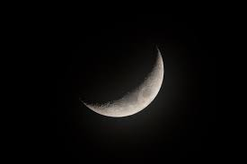
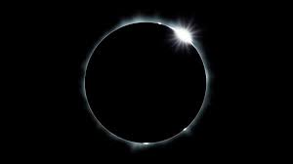
Sophia and Olivia
Phases of the Earth’s Moon
New moon
A new moon can happen when the sun is directly in line with the moon. During the new moon it is pitch black which makes that cool effect.
Waxing crescent
The waxing crescent is when the moon is in it’s second cycle and getting bigger.

Slide 12
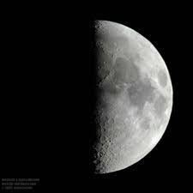
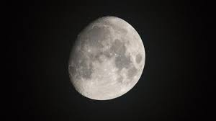
Ashton
First quarter moon
The first quarter means the moon is in the first quarter of it’s cycle.
Some people call the first quarter moon a half moon.
Waxing gibbous
The waxing gibbous is when the moon is nearly a full moon and is nearly half way through it’s cycle.

Slide 13
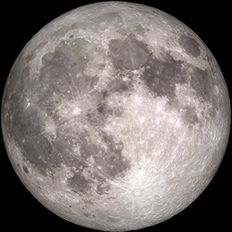
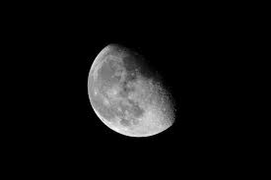
Brayden
The Full Moon
The full moon is the largest you will ever see the moon. When the moon is full it is also the brightest it can be.
The Waning gibbous
The word waning means getting smaller so obviously the moon is getting smaller.

Slide 14
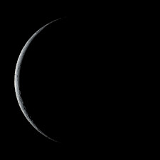
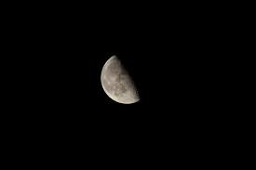
Joseph and Josh
The third quarter
The third quarter is when the moon is a third quarter through its cycle.
The waning crescent
The waning crescent moon is when the moon finishes its cycle in which after that, the cycle repeats itself over and over again.

Slide 15
We are looking forward to Semester 2 in 2021!

