Slide 1
What have 3/4C been up to in Semester 1?
Mrs Cormack

Slide 2
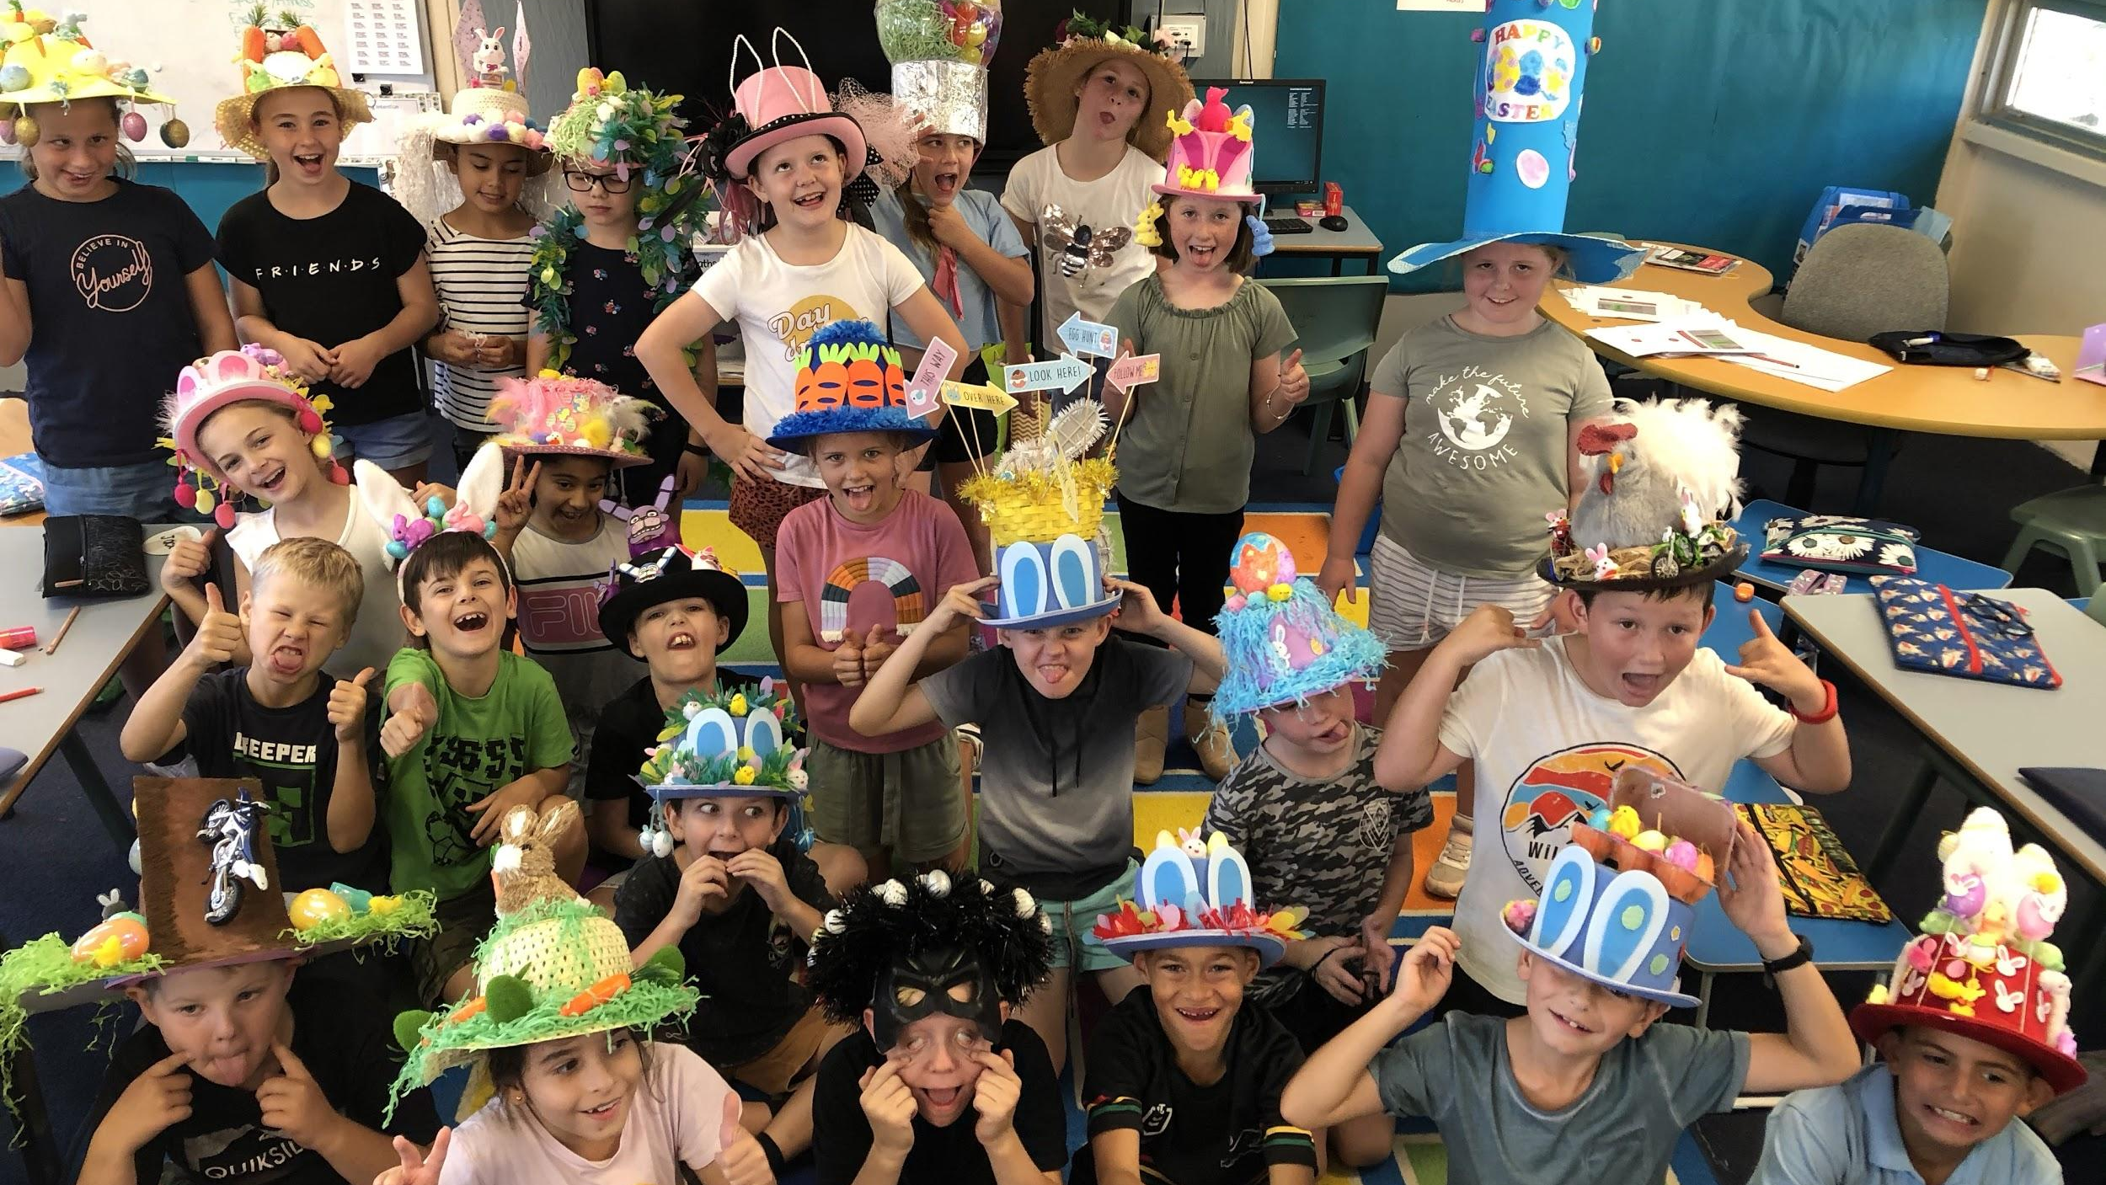
Easter hat madness!

Slide 3
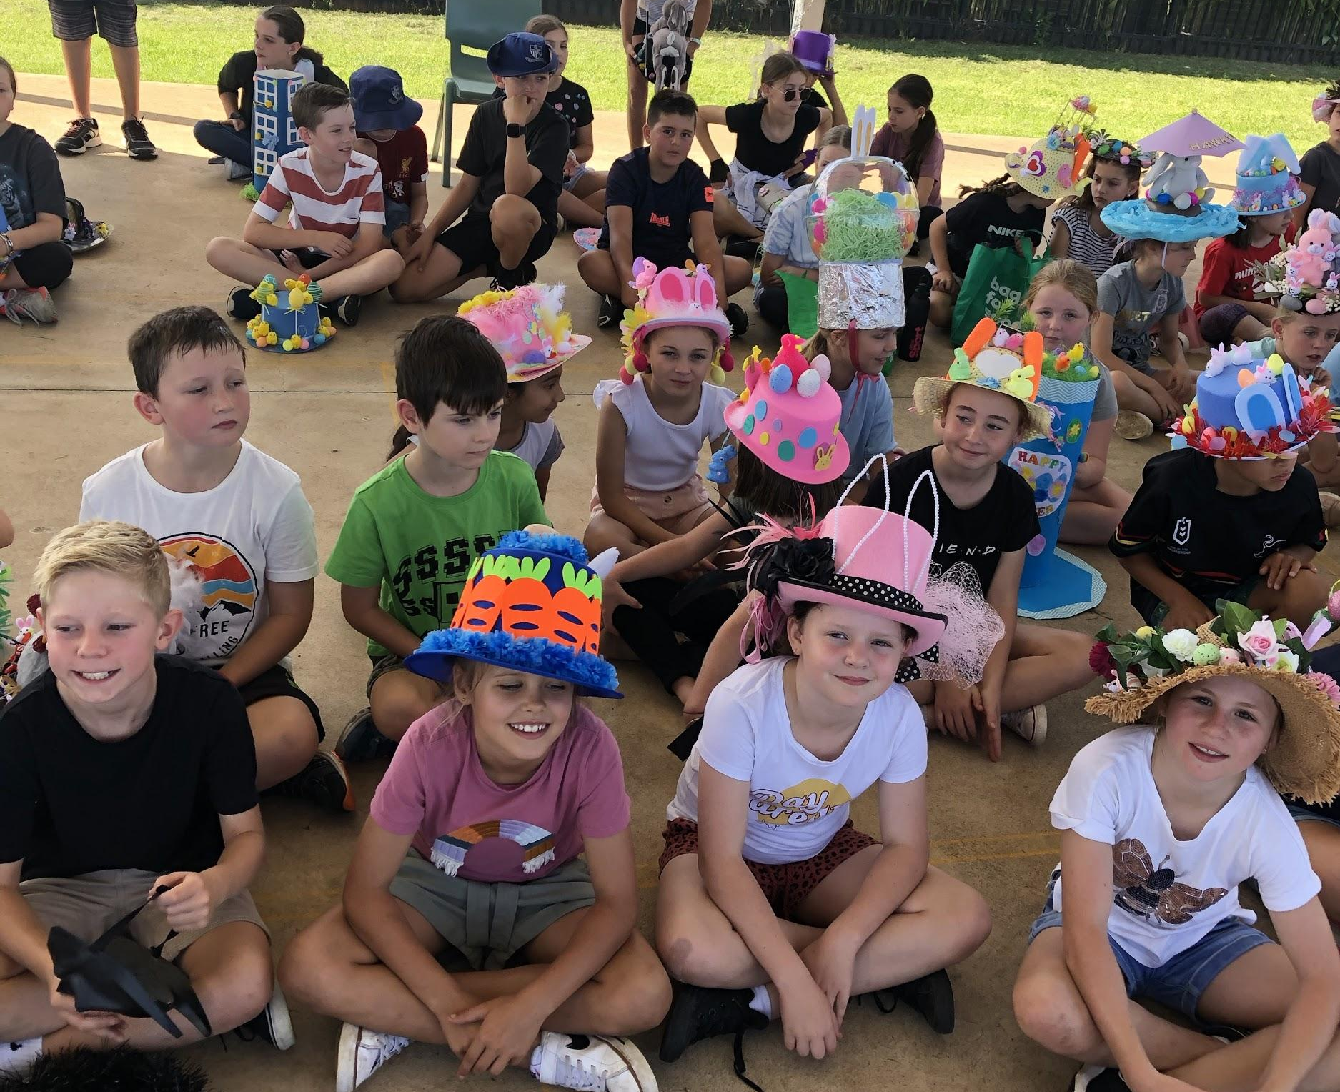
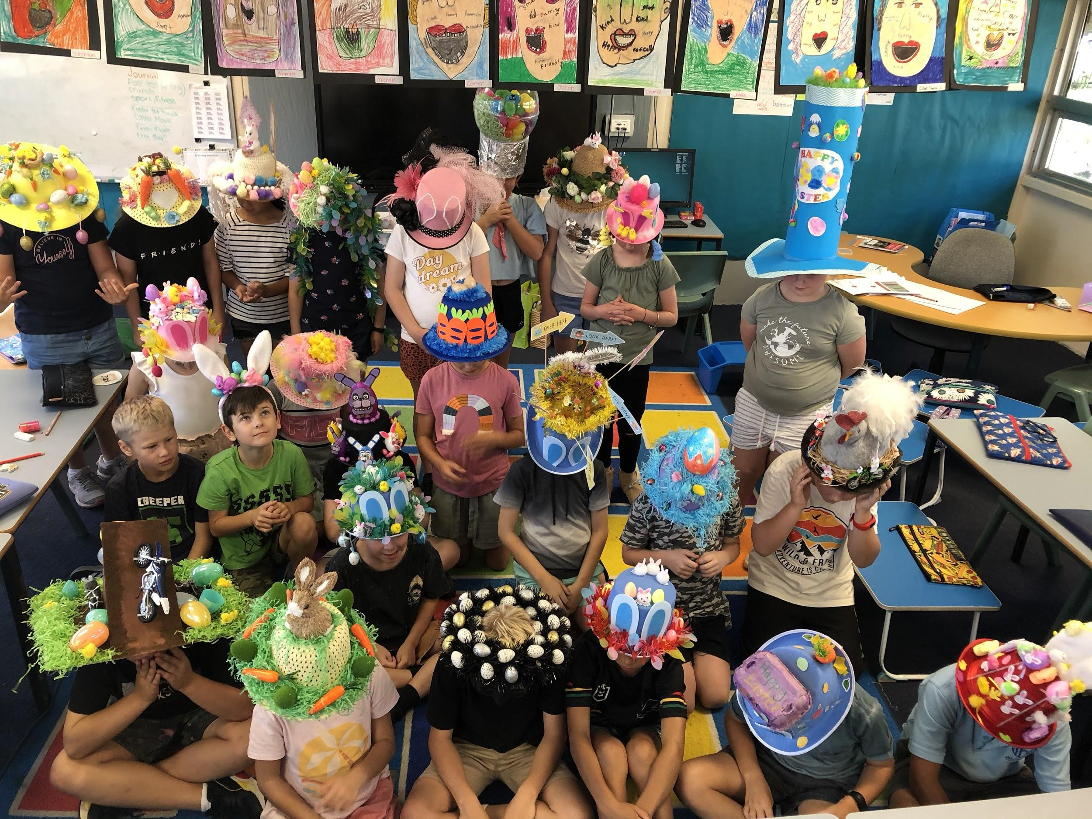
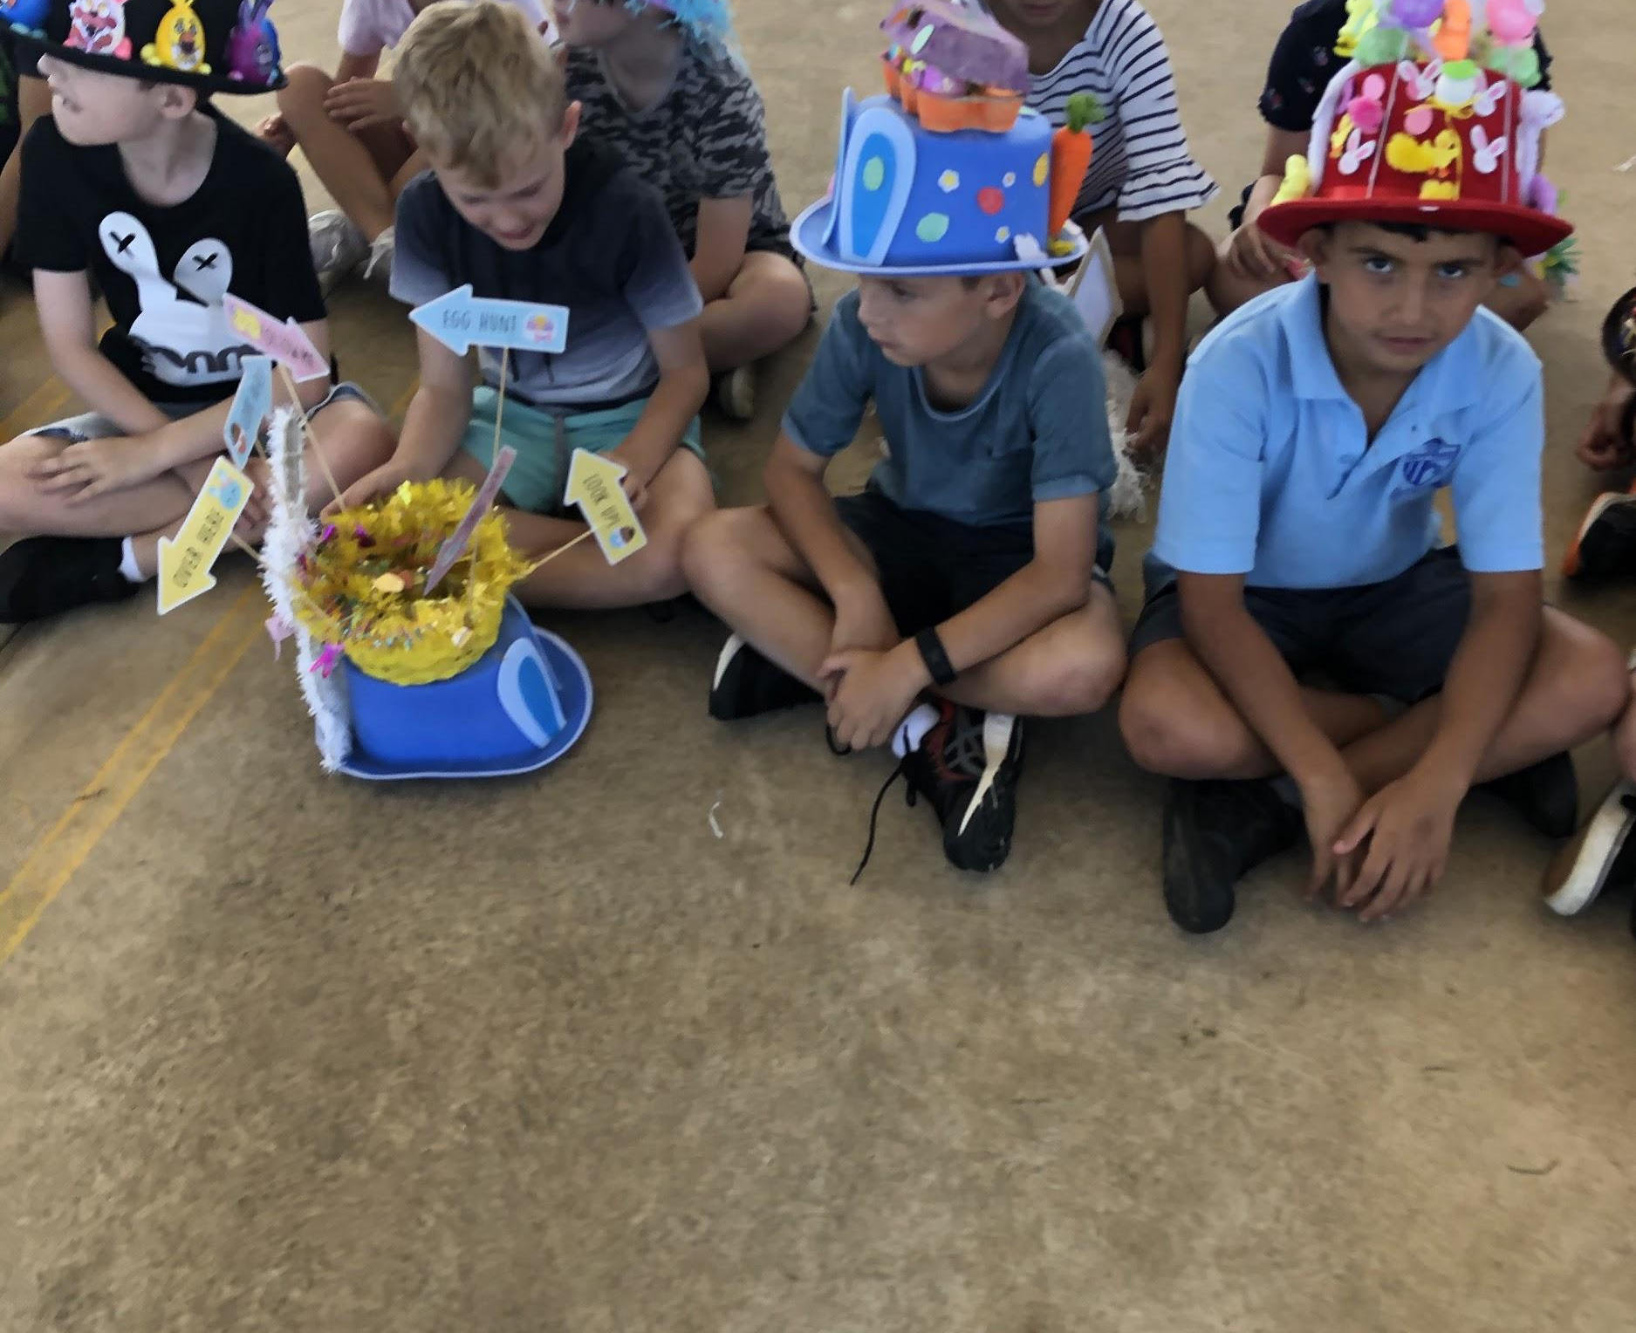
A fantastic effort 3/4C!
Thank you for all your help making our hats amazing!

Slide 4
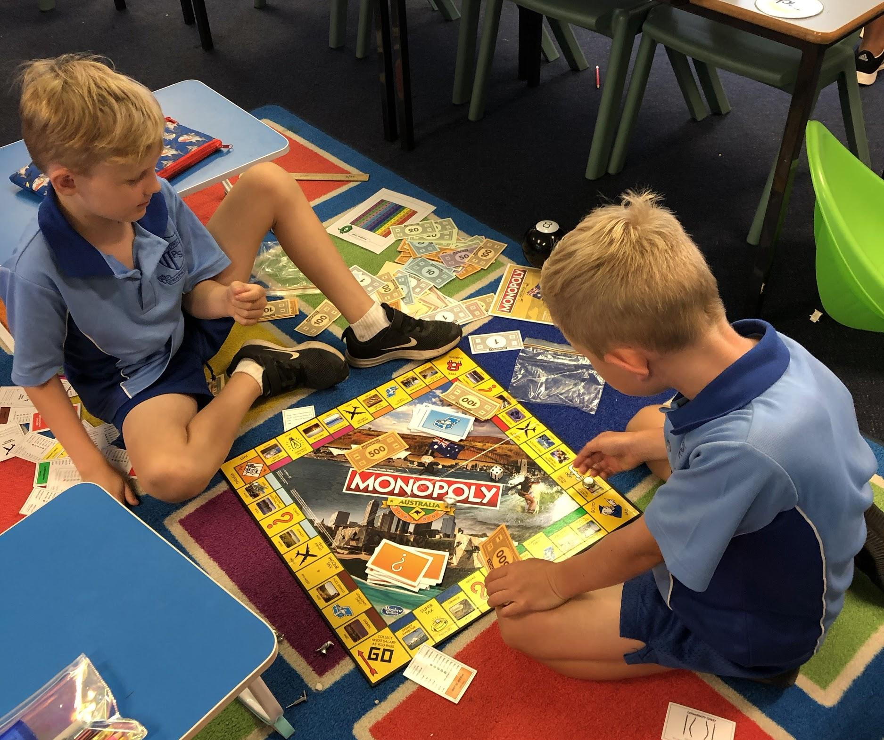
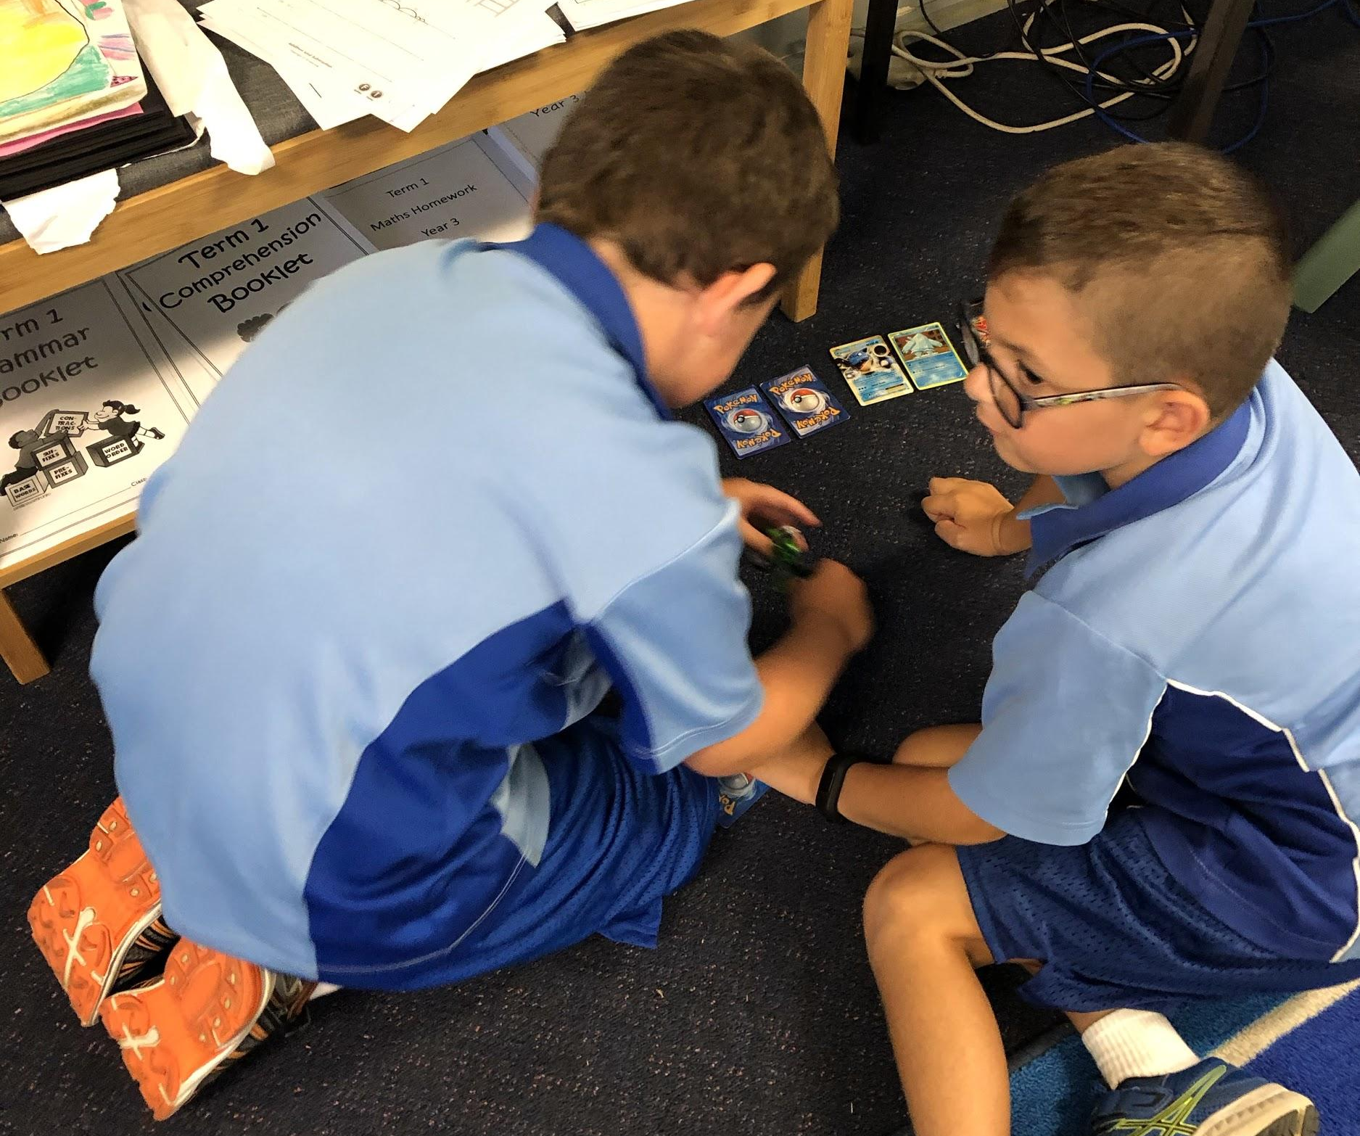
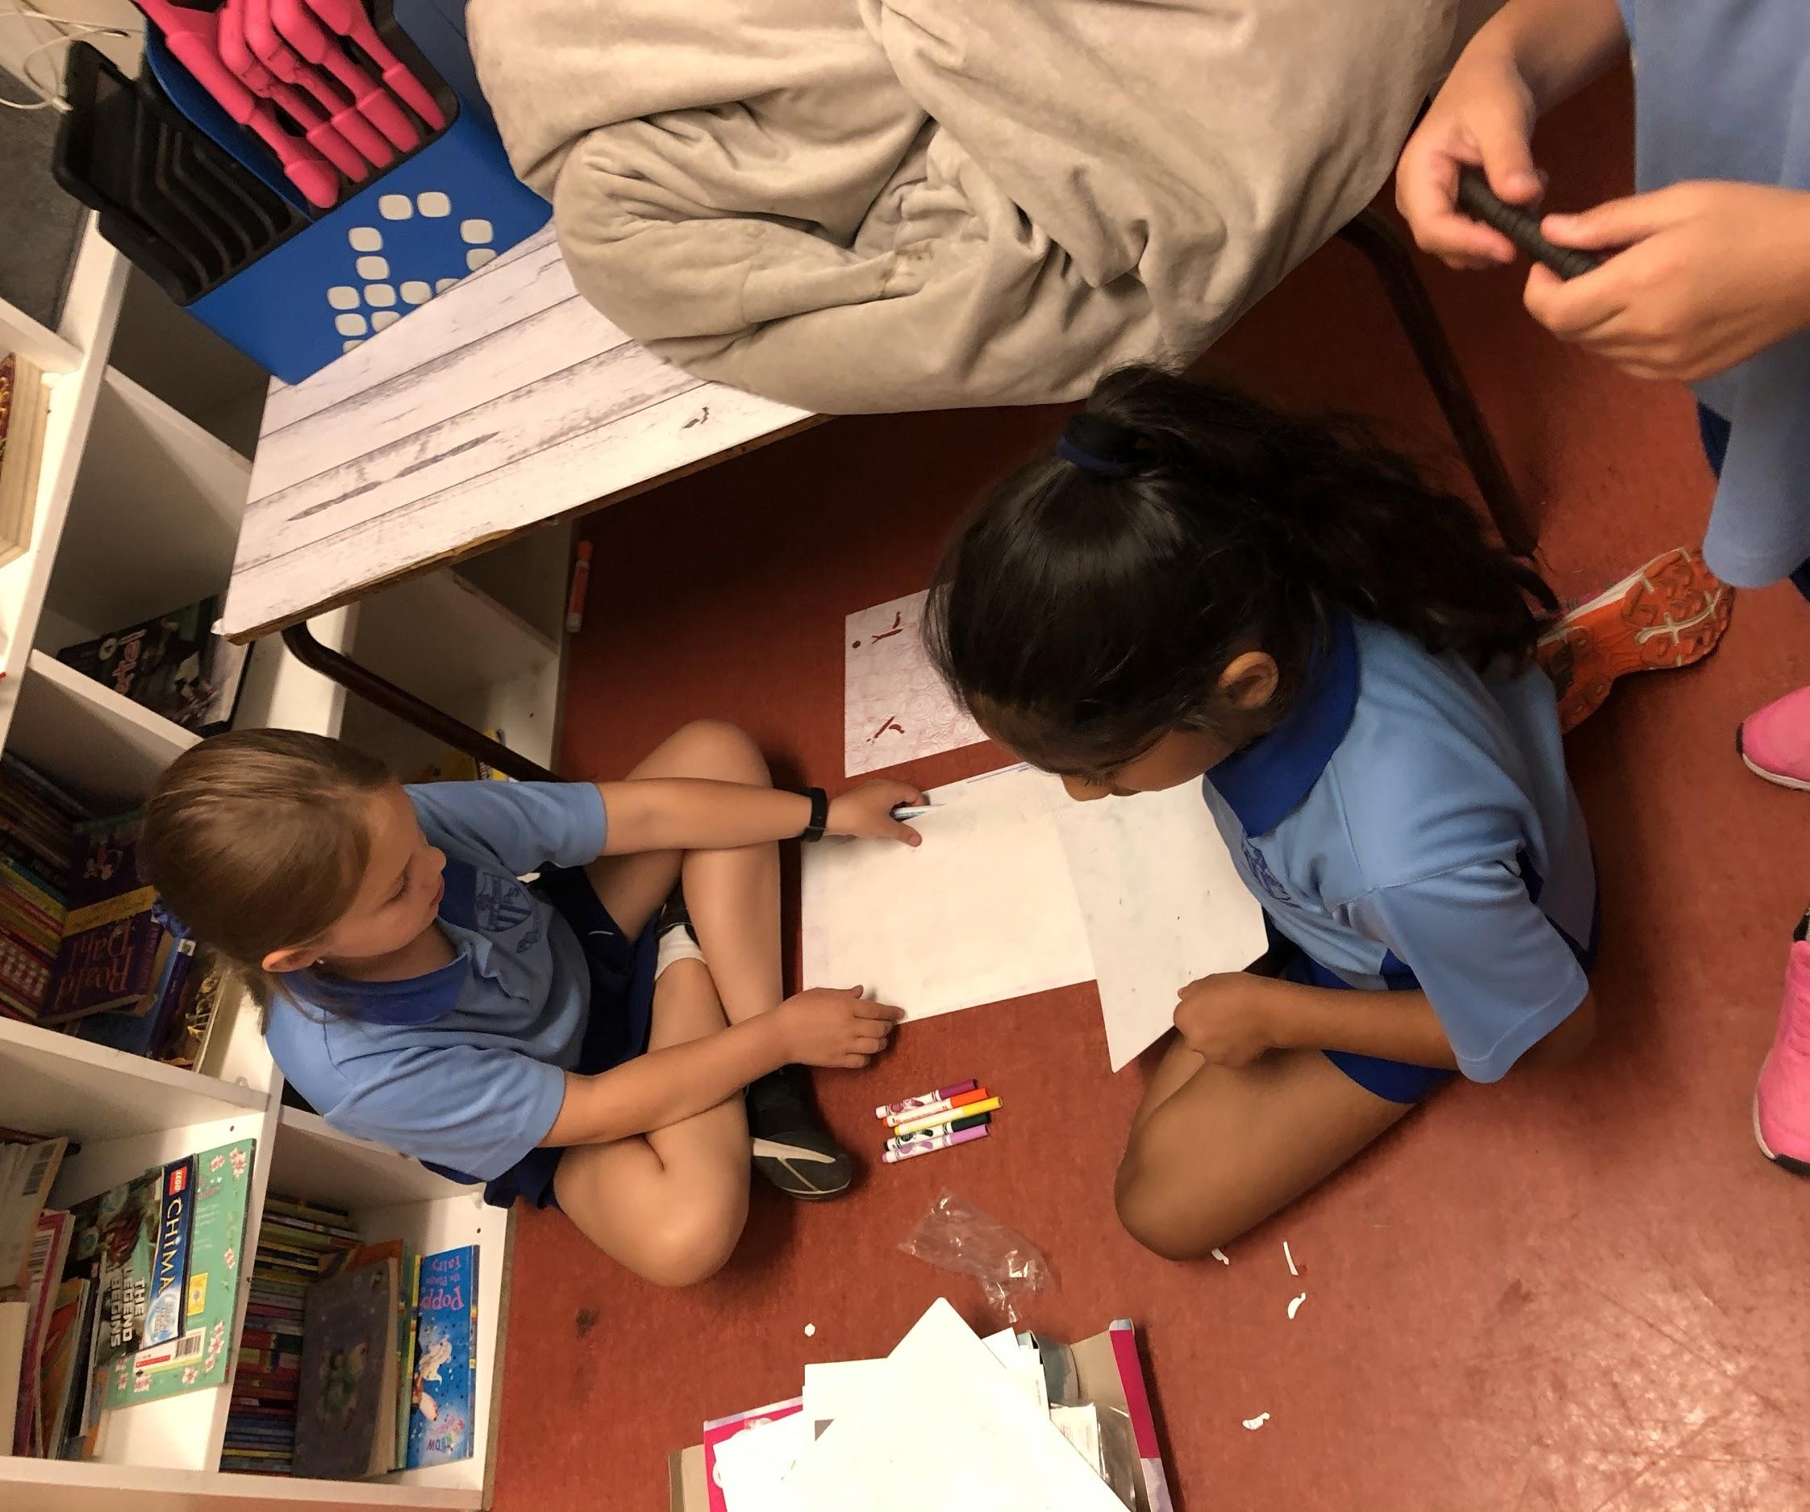
International Play Day

Slide 5
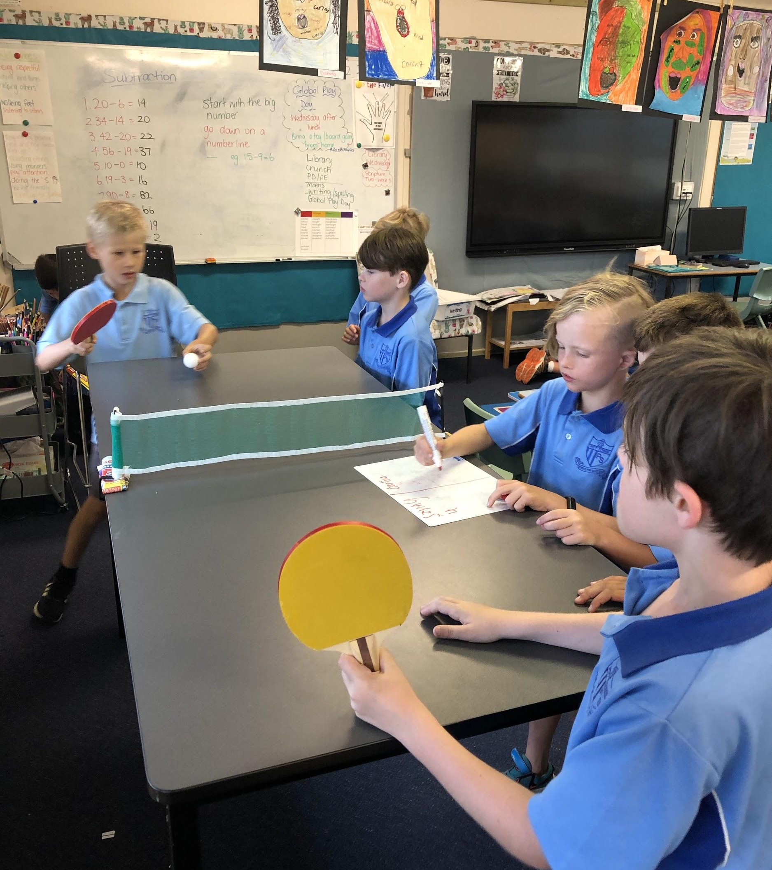
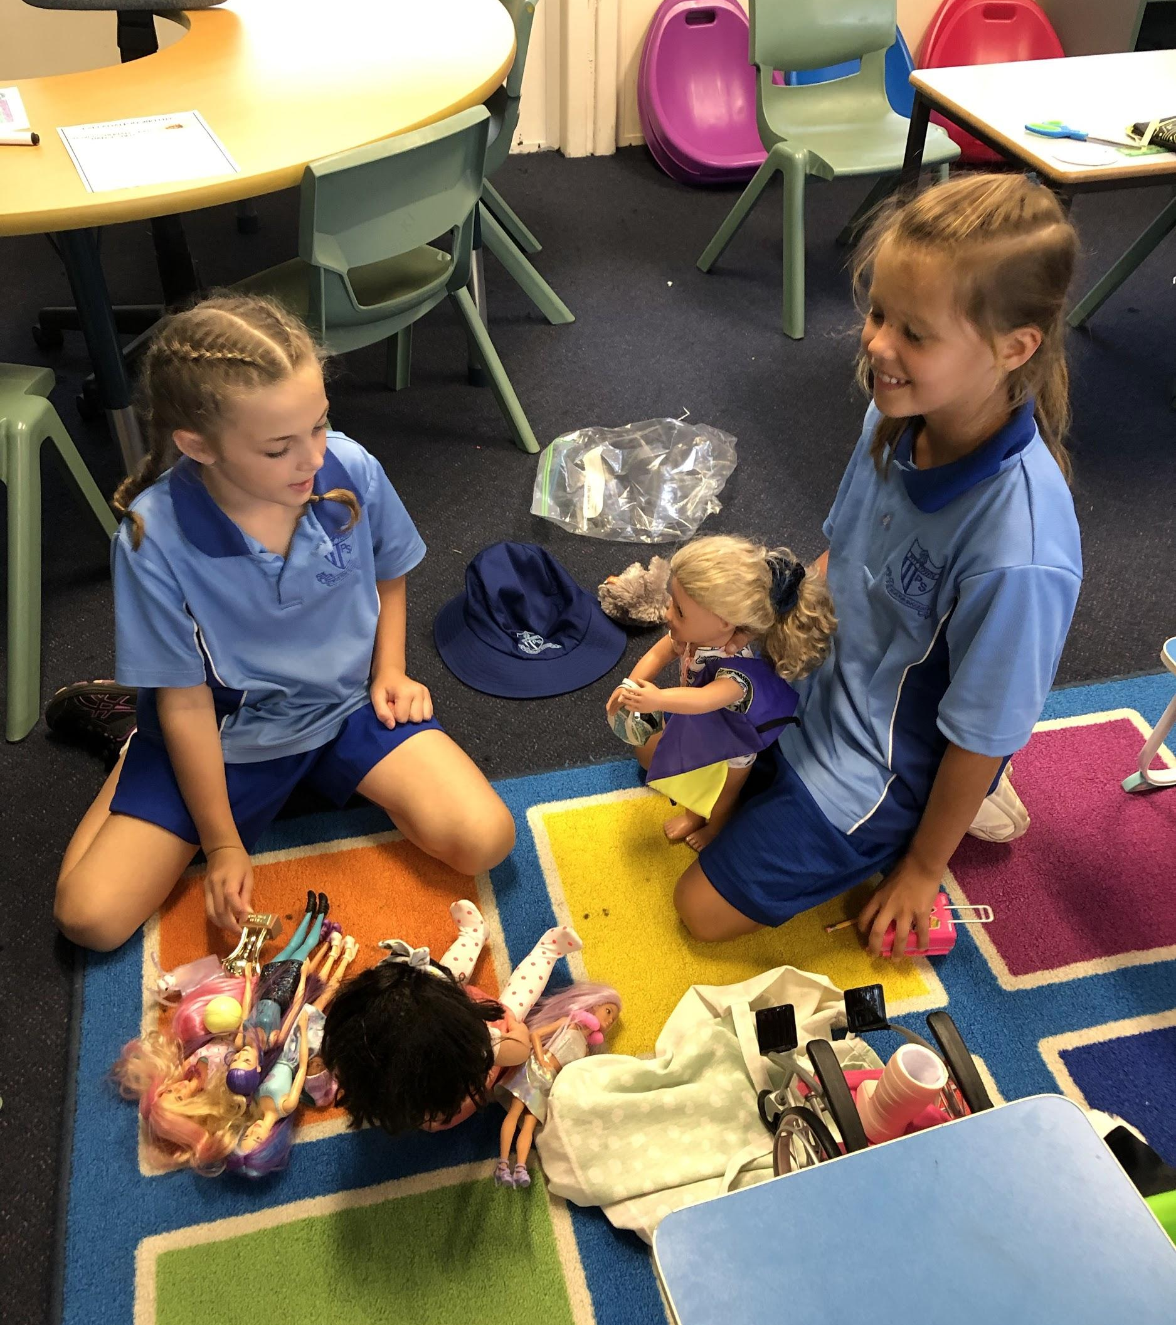

Slide 6
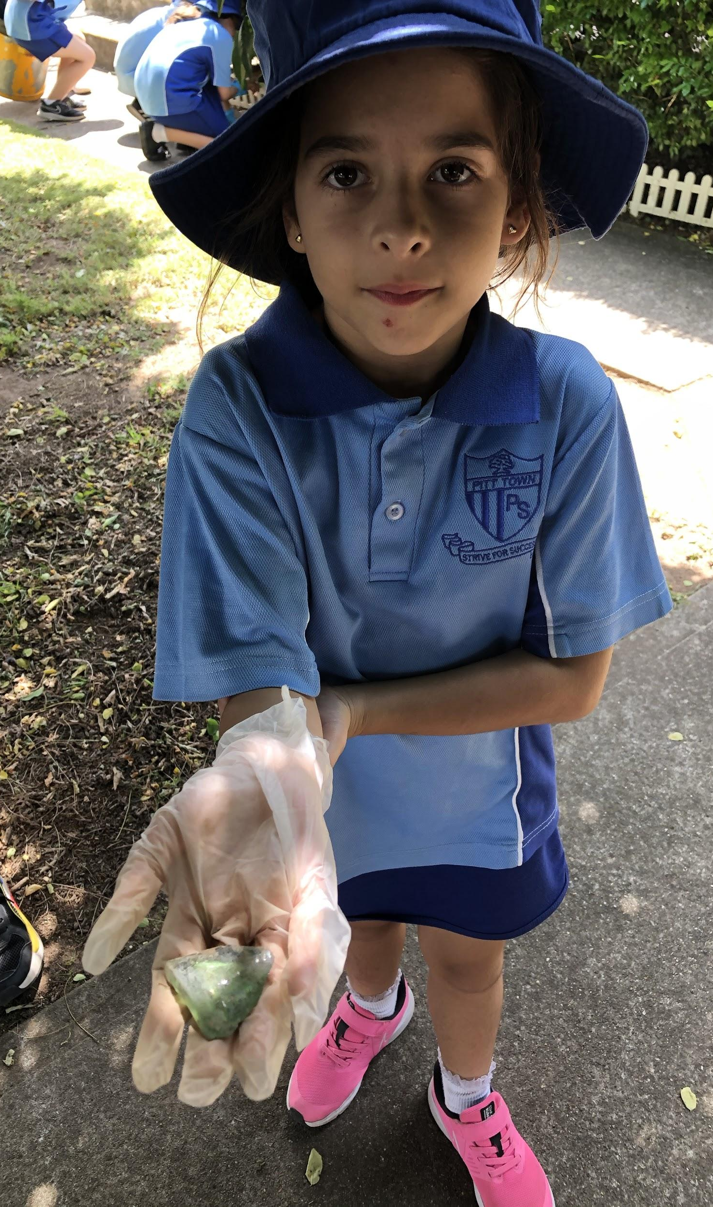
Taking pride in our school by participating in Clean Up Australia Day and writing about our
reasons why we do it with friends

Slide 7
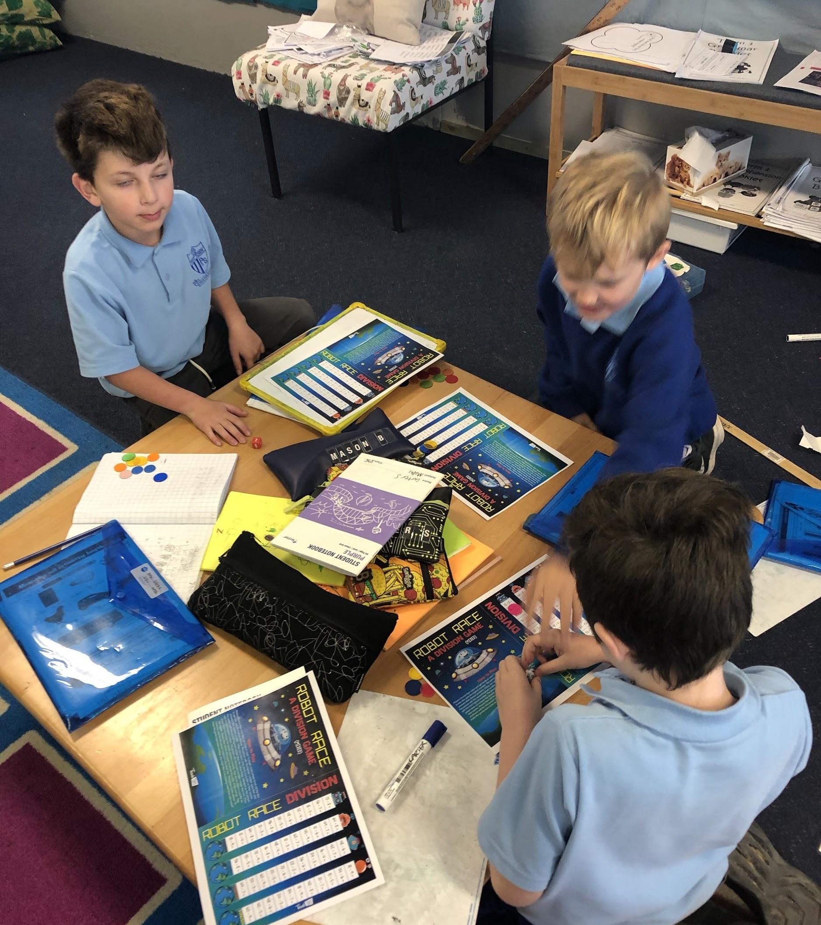
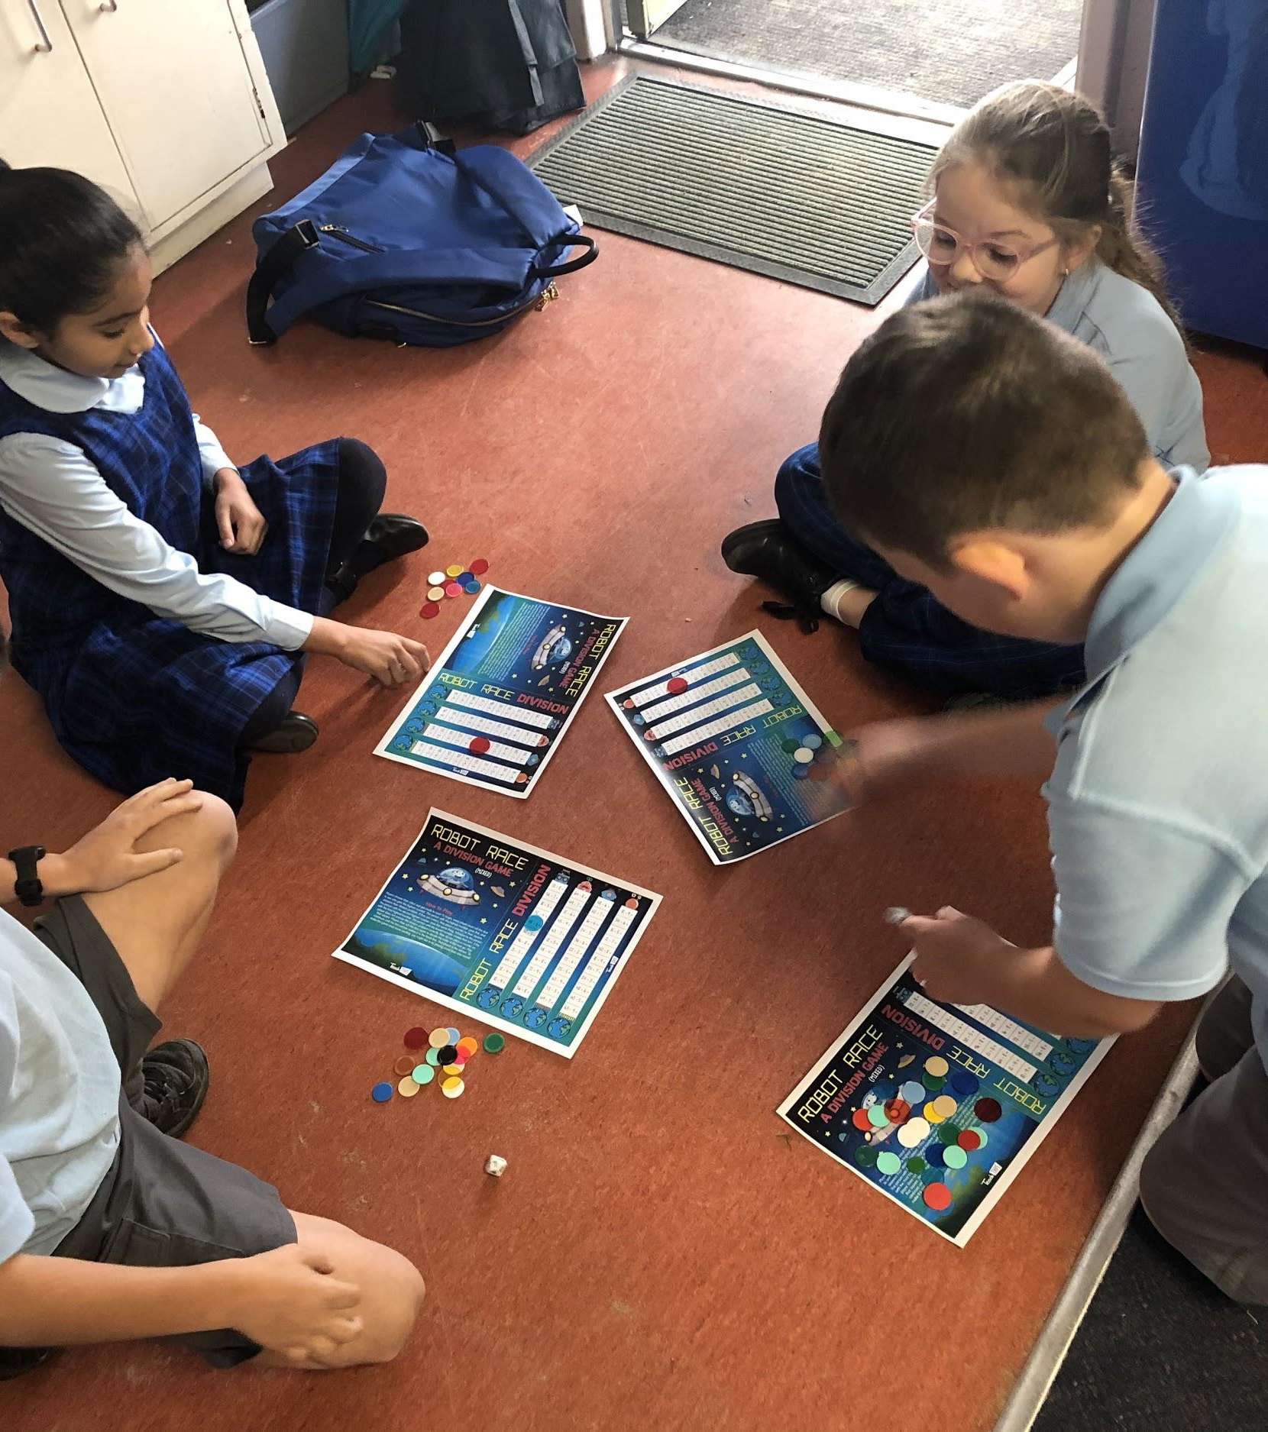
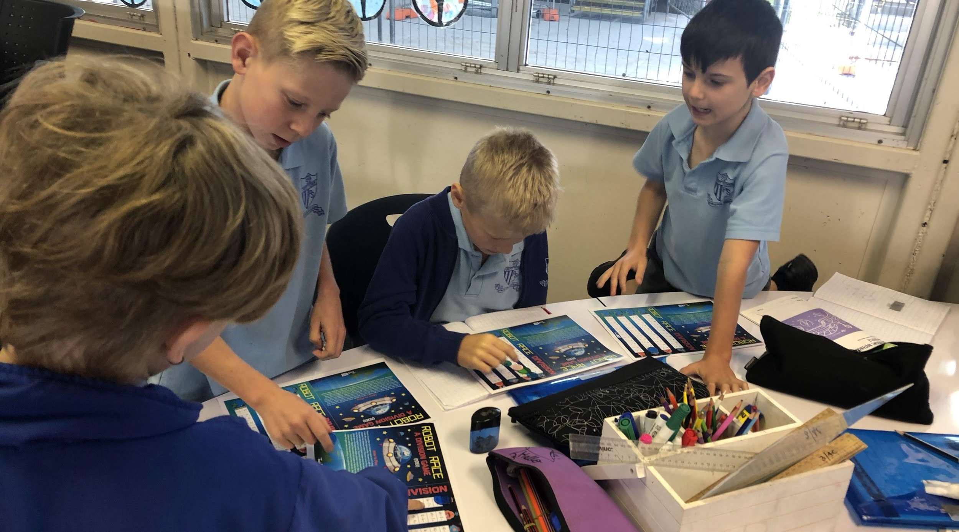
Working hard on our multiplication and division facts by playing
collaboratively

Slide 8
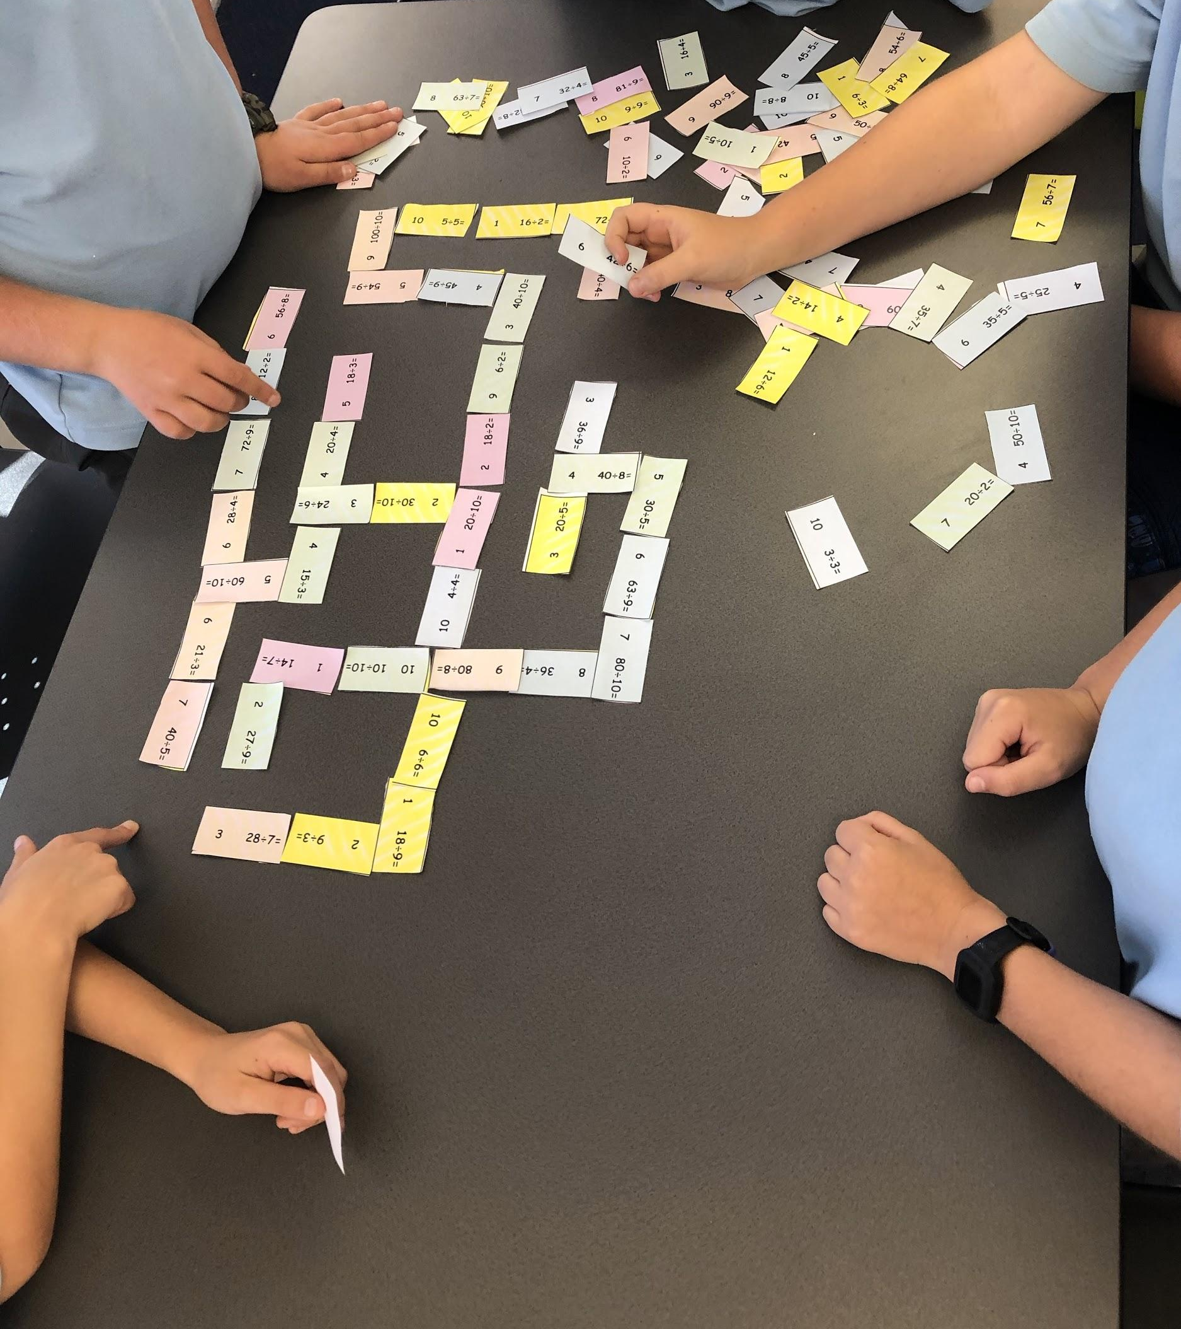
Division dominoes are a fun way to recognise different number combinations

Slide 9
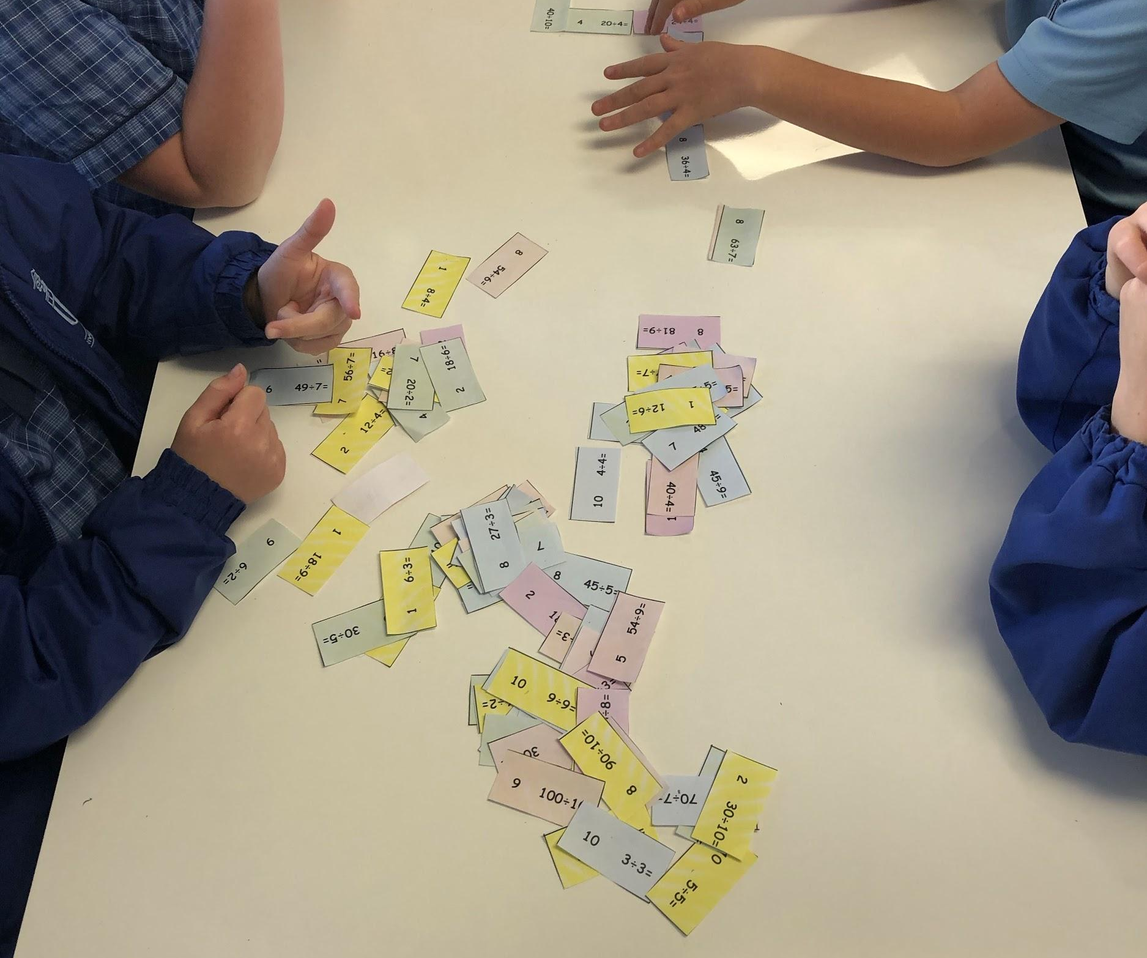
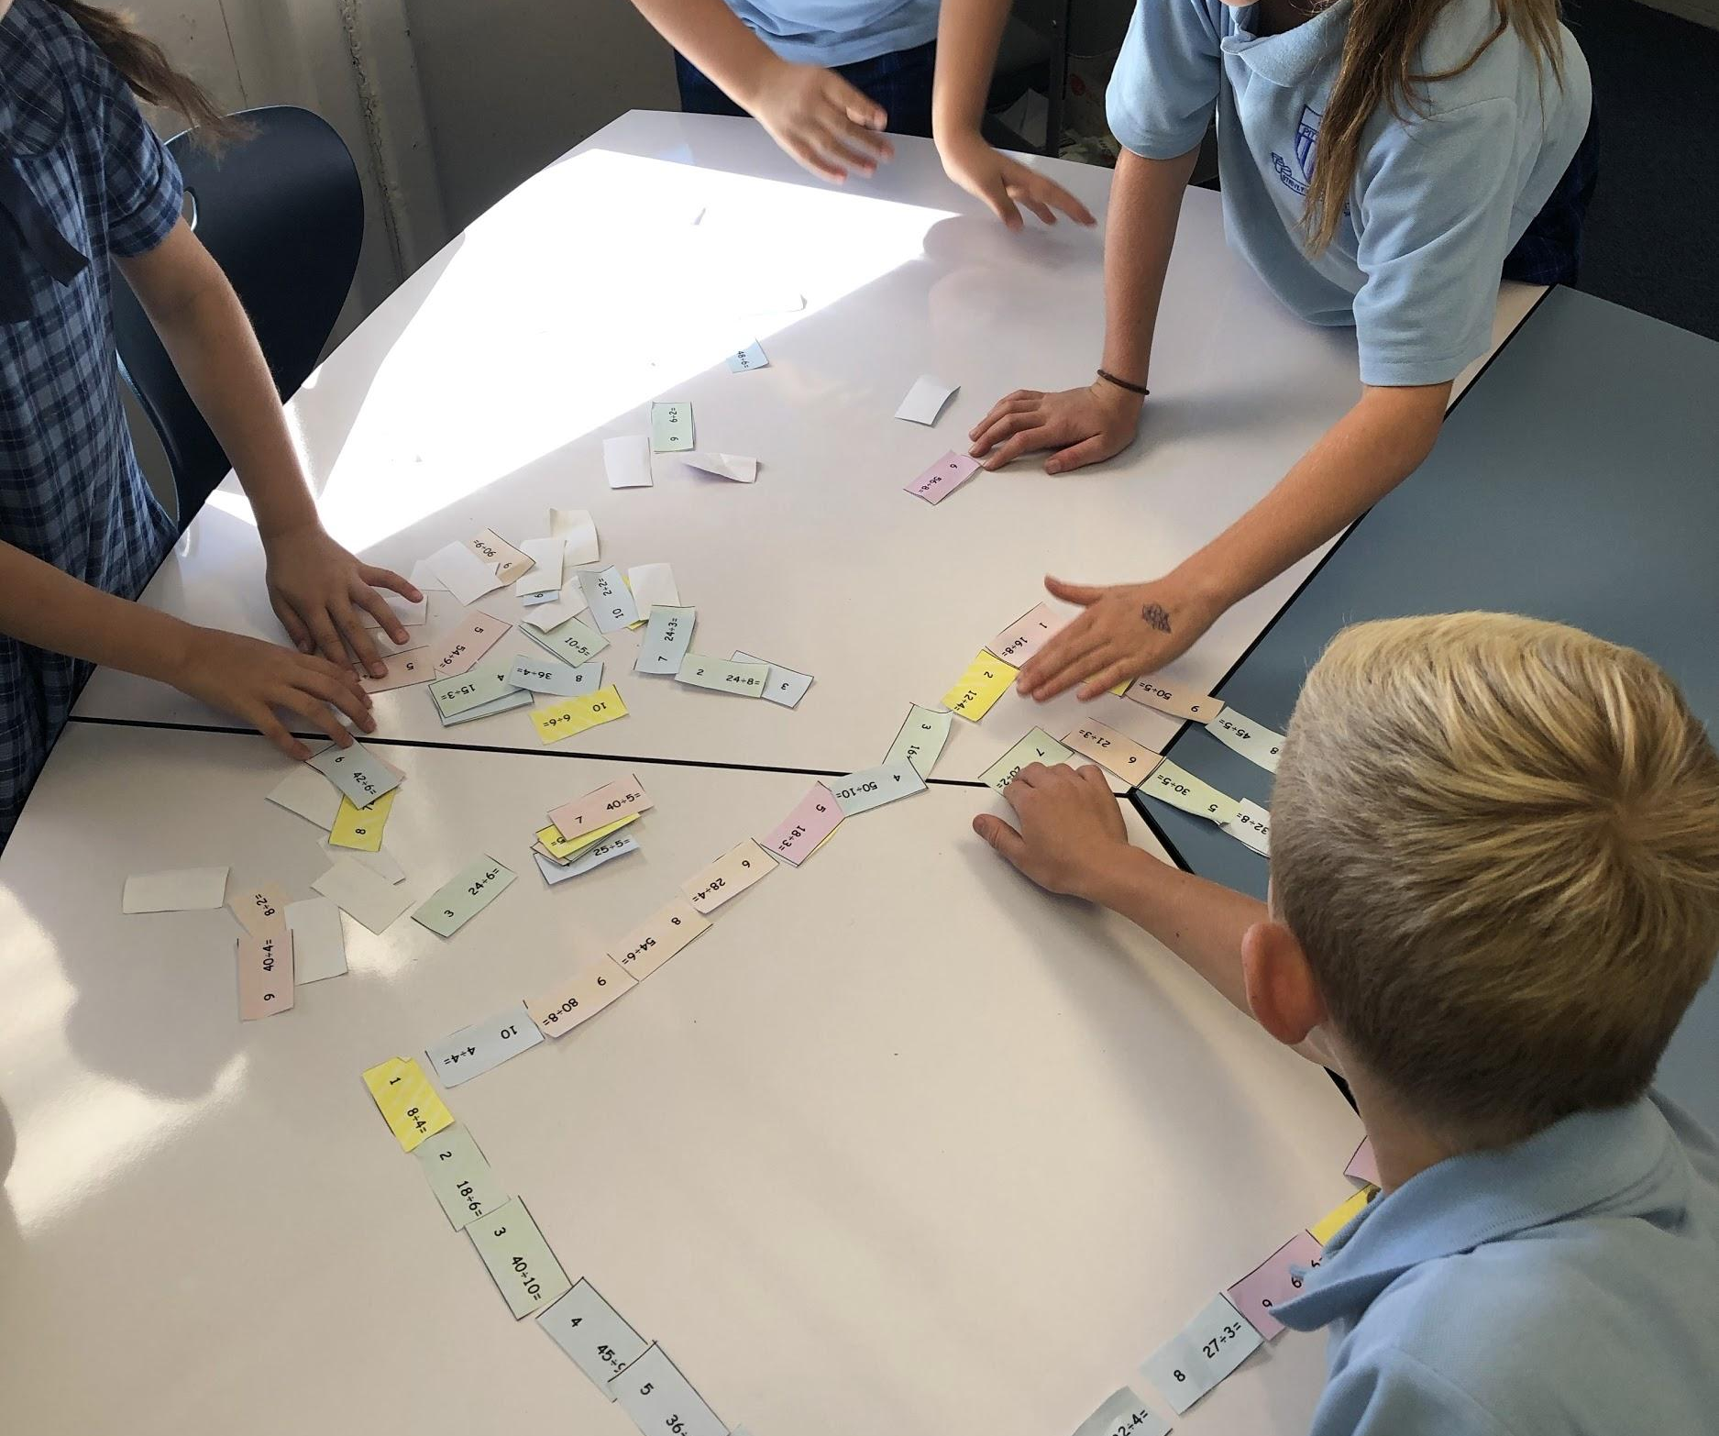
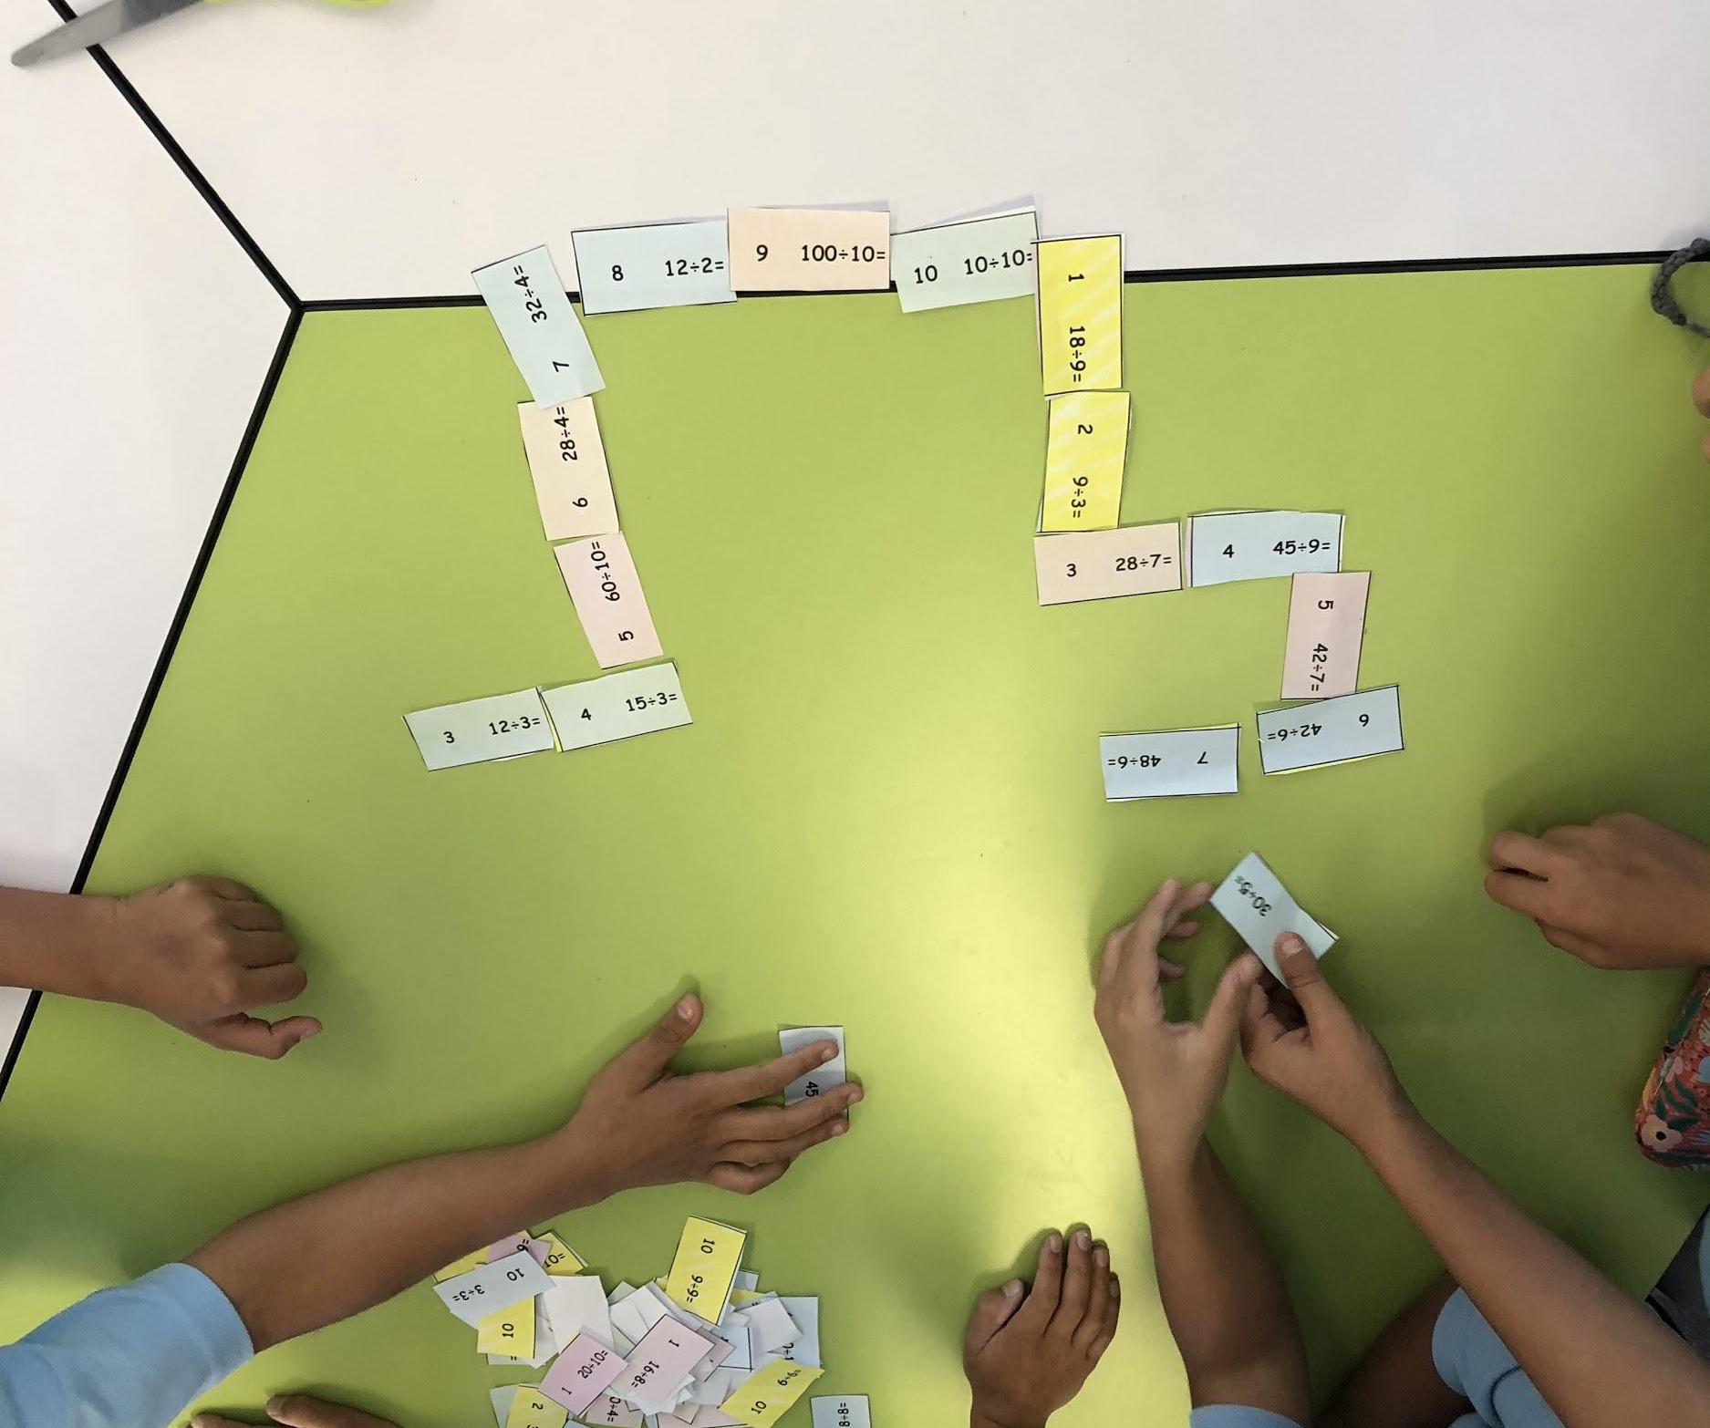

Slide 10
Discovering we love to code! Using Lego WeDo to build, engineer and code our creation to move.

Slide 11
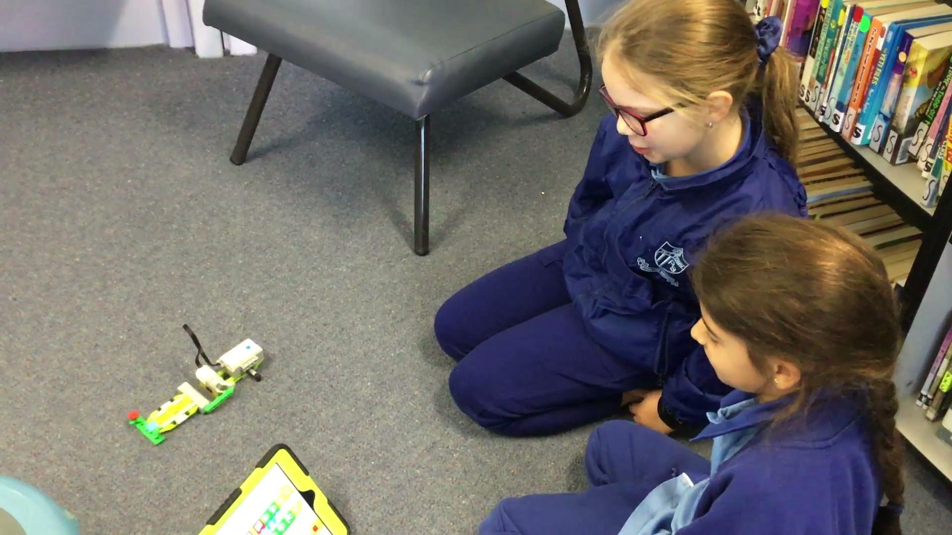
Being an engineer and code designer is tricky! We have to problem solve, use teamwork, and learn from our mistakes

Slide 12
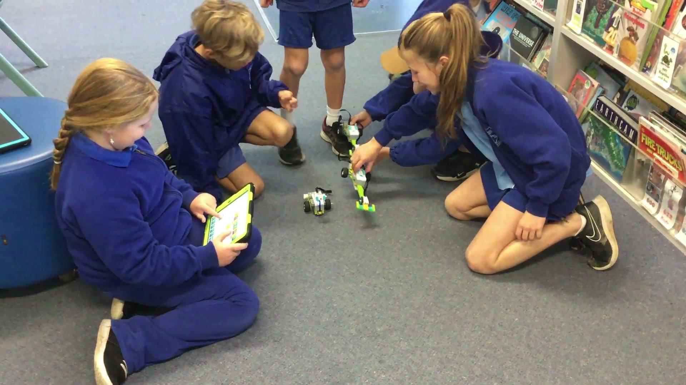
Why is
it only
Going

Slide 13
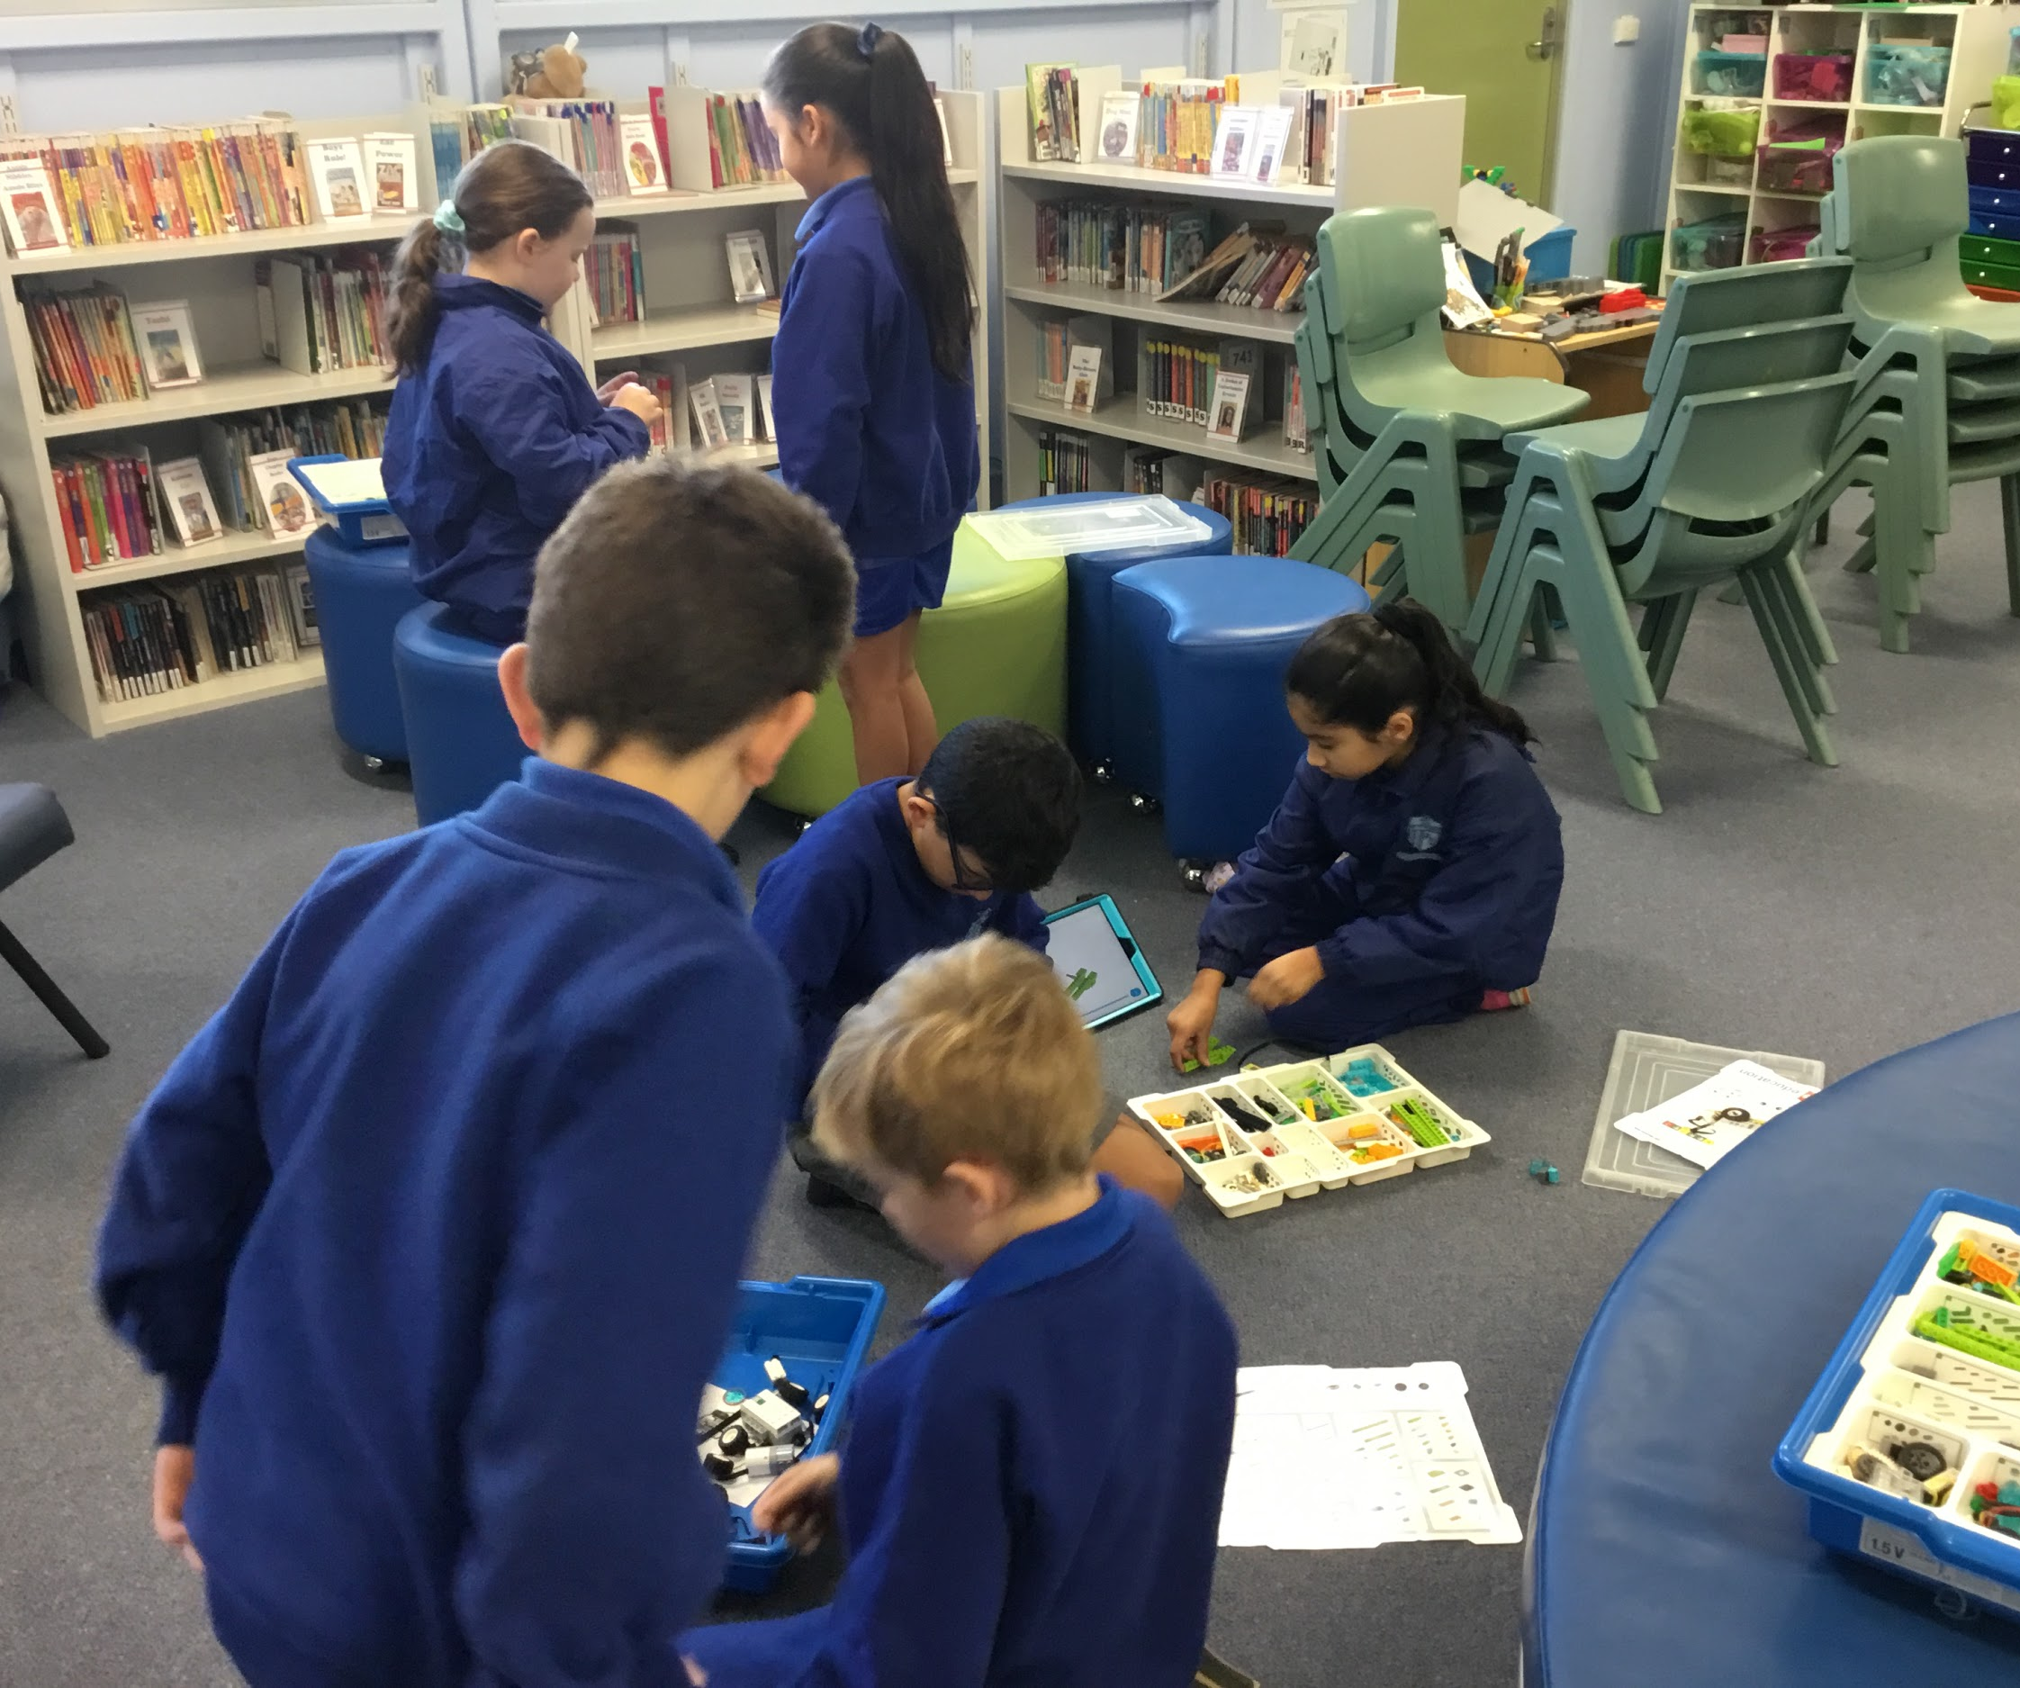
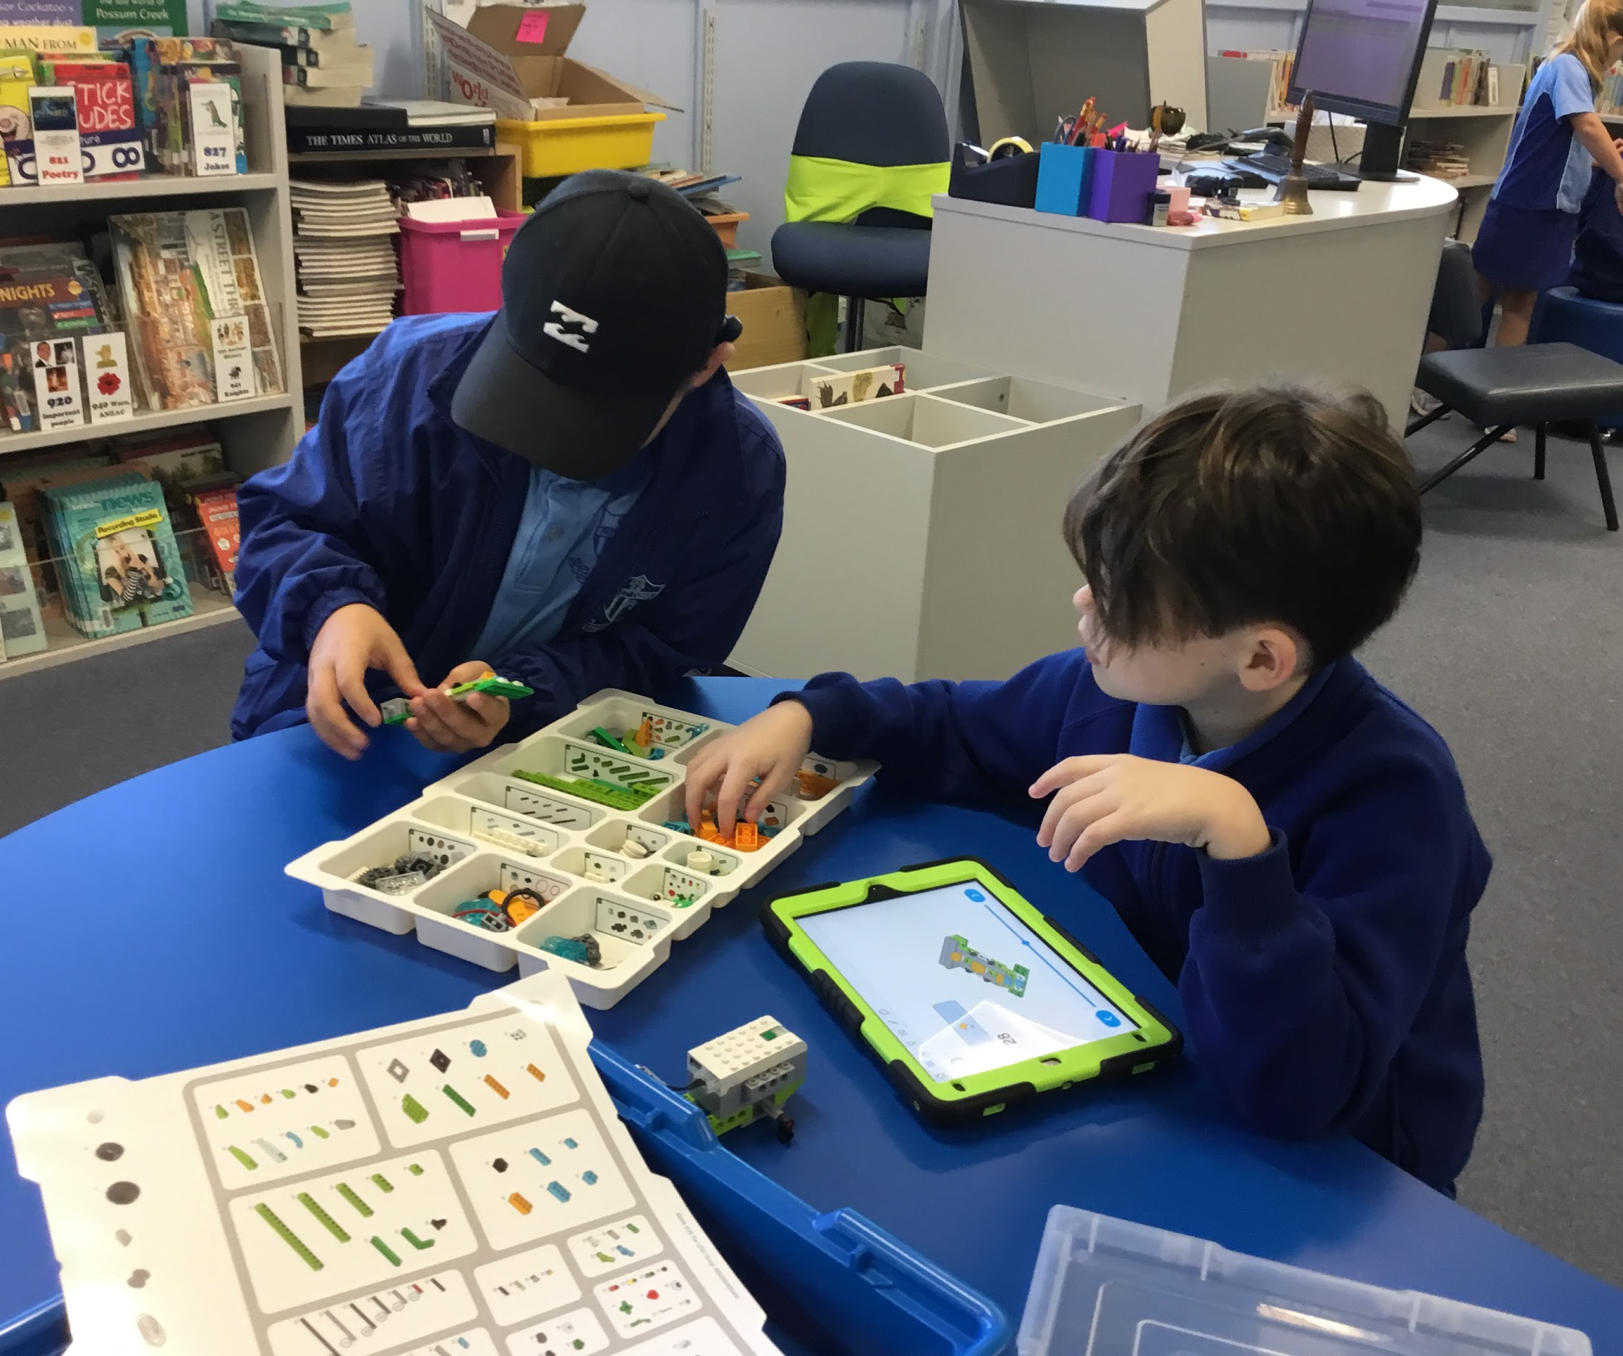

Slide 14
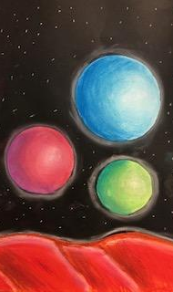
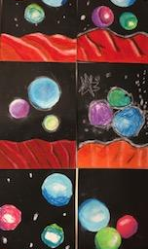
Planet Art using chalk pastels- practicing how to shade and add depth and dimensions to our work

Slide 15
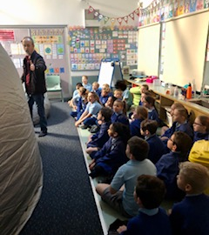
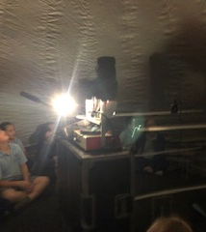
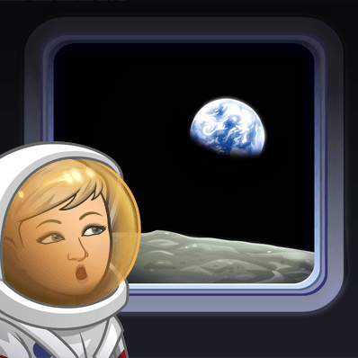
Getting ready for our visit in the Planetarium. We were very excited and learnt so much!

Slide 16
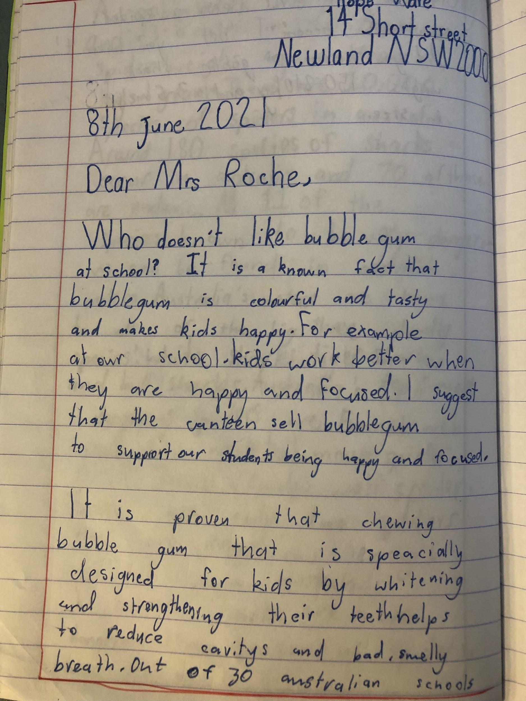
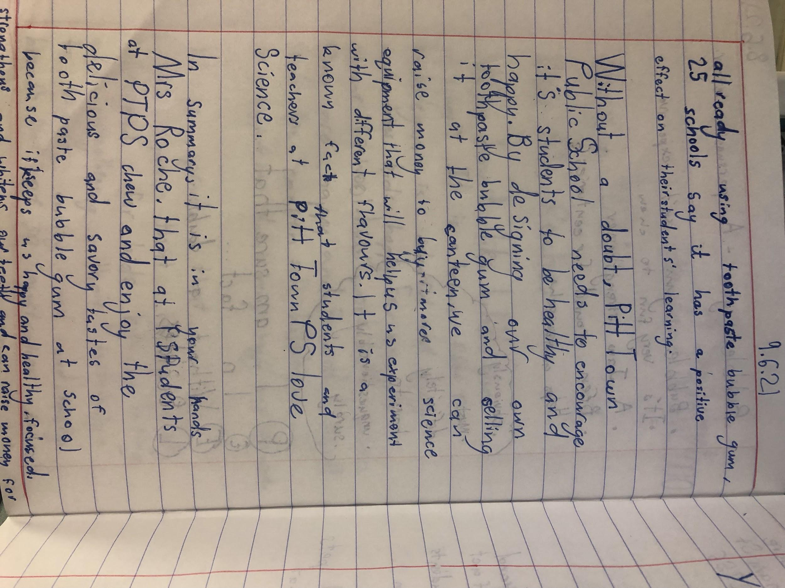
Developing our persuasive writing skills … Poor Mrs Roche!

Slide 17
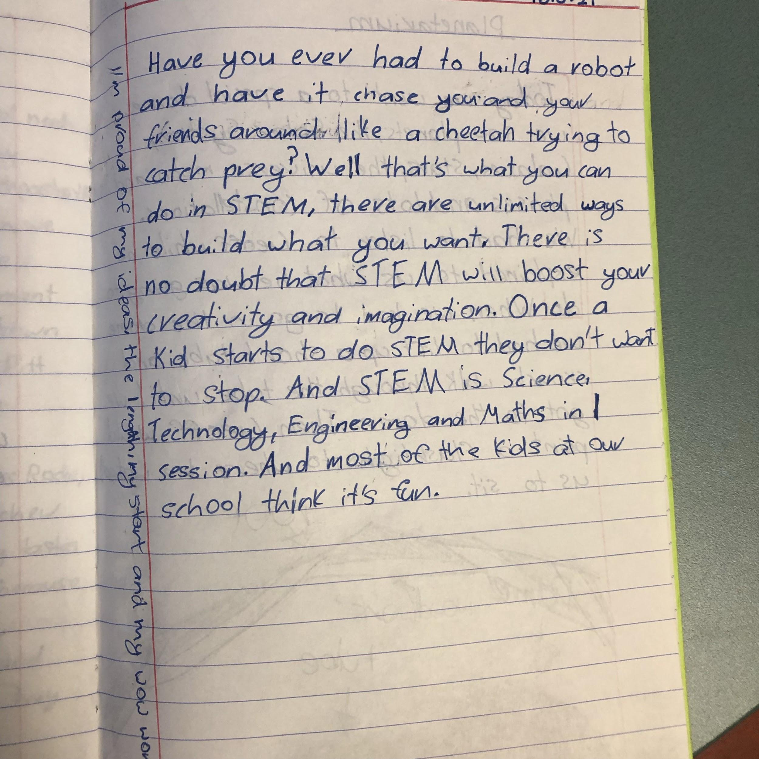
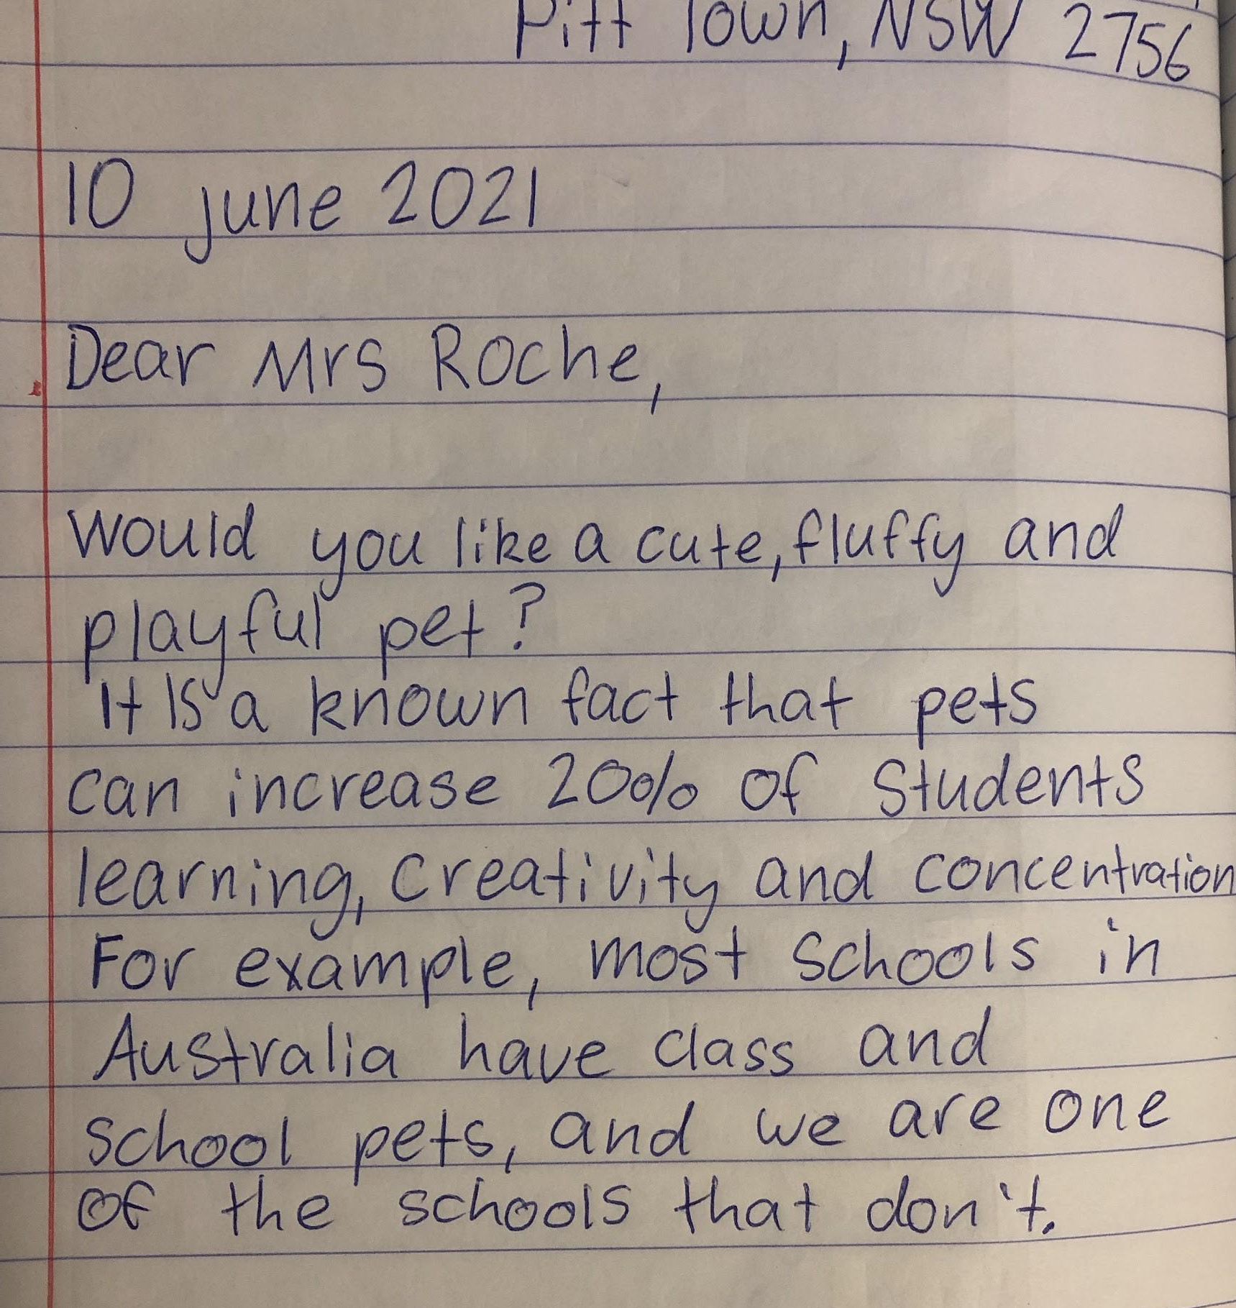

Slide 18
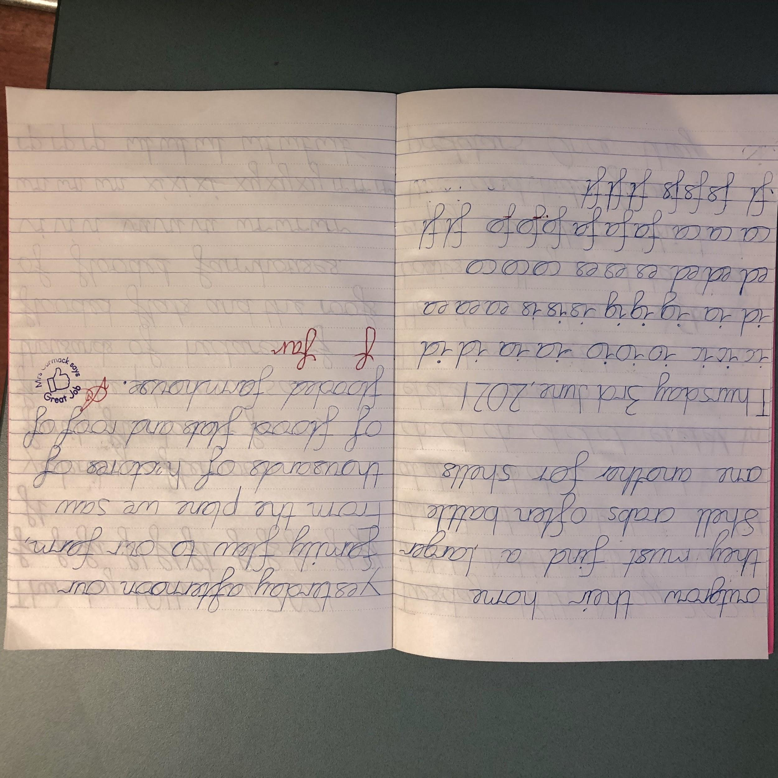
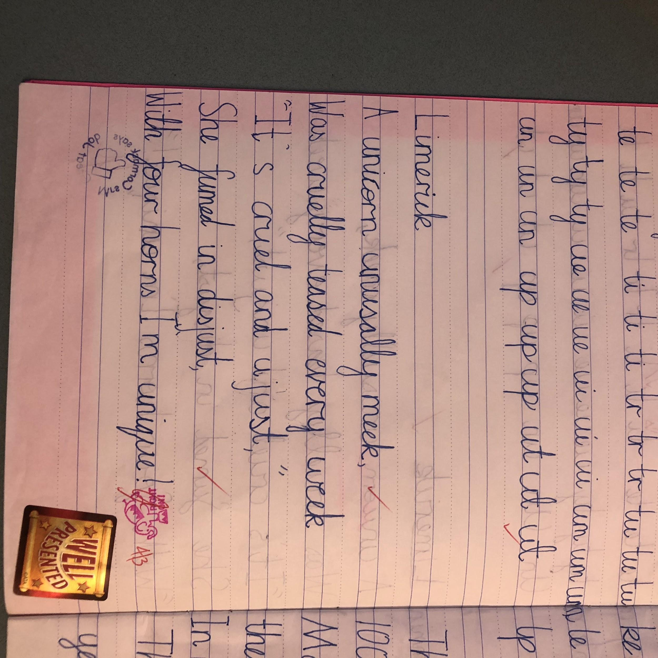
Handwriting success! Cursive can be tricky to learn

Slide 19
Thanks for taking a trip down memory lane with us!
We look forward to seeing everyone during Education Week in Term 3 for our open classrooms

